Slide 1
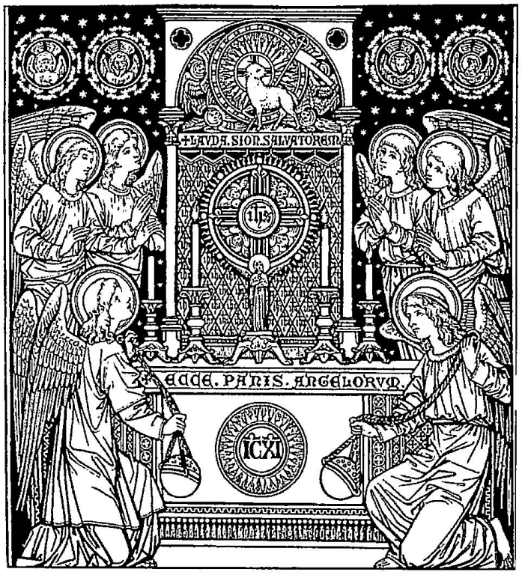

Slide 2
O SALUTARIS Hostia
O SAVING Victim opening wide
Quae caeli pandis ostium.
The gate of heaven to all below.
Bella premunt hostilia;
Our foes press on from every side;
Da robur, fer auxilium.
Thine aid supply, Thy strength bestow.

Slide 3
Uni trinoque Domino
To Thy great name be endless praise
Sit sempiterna gloria:
Immortal Godhead, One in Three;
Qui vitam sine termino,
Oh, grant us endless length of days,
Nobis donet in patria.
In our true native land with Thee.
Amen.

Slide 5
Leader:
Eternal Father, I offer You the Body and Blood, Soul and Divinity of Your dearly beloved Son, Our Lord,
Jesus Christ,
All:
In atonement for our sins, and those of the whole world.

Slide 6
Decade 1
Leader:
For the sake of His
sorrowful passion,
All:
Have mercy on us and on
the whole world.

Slide 7
Leader:
Eternal Father, I offer You the Body and Blood, Soul and Divinity of Your dearly beloved Son, Our Lord,
Jesus Christ,
All:
In atonement for our sins, and those of the whole world.

Slide 8
Decade 2
Leader:
For the sake of His
sorrowful passion,
All:
Have mercy on us and on
the whole world.

Slide 9
Leader:
Eternal Father, I offer You the Body and Blood, Soul and Divinity of Your dearly beloved Son, Our Lord,
Jesus Christ,
All:
In atonement for our sins, and those of the whole world.

Slide 10
Decade 3
Leader:
For the sake of His
sorrowful passion,
All:
Have mercy on us and on
the whole world.

Slide 11
Leader:
Eternal Father, I offer You the Body and Blood, Soul and Divinity of Your dearly beloved Son, Our Lord,
Jesus Christ,
All:
In atonement for our sins, and those of the whole world.

Slide 12
Decade 4
Leader:
For the sake of His
sorrowful passion,
All:
Have mercy on us and on
the whole world.

Slide 13
Leader:
Eternal Father, I offer You the Body and Blood, Soul and Divinity of Your dearly beloved Son, Our Lord,
Jesus Christ,
All:
In atonement for our sins, and those of the whole world.

Slide 14
Decade 5
Leader:
For the sake of His
sorrowful passion,
All:
Have mercy on us and on
the whole world.

Slide 15
Holy God, Holy Mighty One,
Holy Immortal One,
Have Mercy on us,
and one the whole world.
(3x)

Slide 16
Lider:
Padre Eterno, te ofrezco el Cuerpo y la Sangre, el alma y la divinidad de tu Amadísimo Hijo,
nuestro Señor Jesucristo,
Todos:
como propiciación de nuestros pecados y los del mundo entero

Slide 17
Primera decena
Lider:
Por Su dolorosa Pasión
Todos:
Ten misericordia de nosotros
y del mundo entero

Slide 18
Lider:
Padre Eterno, te ofrezco el Cuerpo y la Sangre, el alma y la divinidad de tu Amadísimo Hijo,
nuestro Señor Jesucristo,
Todos:
como propiciación de nuestros pecados y los del mundo entero

Slide 19
Segunda decena
Lider:
Por Su dolorosa Pasión
Todos:
Ten misericordia de nosotros
y del mundo entero

Slide 20
Lider:
Padre Eterno, te ofrezco el Cuerpo y la Sangre, el alma y la divinidad de tu Amadísimo Hijo,
nuestro Señor Jesucristo,
Todos:
como propiciación de nuestros pecados y los del mundo entero

Slide 21
Tercera decena
Lider:
Por Su dolorosa Pasión
Todos:
Ten misericordia de nosotros
y del mundo entero

Slide 22
Lider:
Padre Eterno, te ofrezco el Cuerpo y la Sangre, el alma y la divinidad de tu Amadísimo Hijo,
nuestro Señor Jesucristo,
Todos:
como propiciación de nuestros pecados y los del mundo entero

Slide 23
Cuarta decena
Lider:
Por Su dolorosa Pasión
Todos:
Ten misericordia de nosotros
y del mundo entero

Slide 24
Lider:
Padre Eterno, te ofrezco el Cuerpo y la Sangre, el alma y la divinidad de tu Amadísimo Hijo,
nuestro Señor Jesucristo,
Todos:
como propiciación de nuestros pecados y los del mundo entero

Slide 25
Quinta decena
Lider:
Por Su dolorosa Pasión
Todos:
Ten misericordia de nosotros y del mundo entero

Slide 26
Holy God, Holy Mighty One,
Holy Immortal One,
Have Mercy on us,
and one the whole world.
(3x)

Slide 27
Lider:
Padre Eterno, te ofrezco el Cuerpo y la Sangre, el alma y la divinidad de tu Amadísimo Hijo,
nuestro Señor Jesucristo,
Todos:
como propiciación de nuestros pecados y los del mundo entero

Slide 28
Primera decena
Lider:
Por Su dolorosa Pasión
Todos:
Ten misericordia de nosotros
y del mundo entero

Slide 29
Decade 1
Leader:
For the sake of His
sorrowful passion,
All:
Have mercy on us and on
the whole world.

Slide 30
Leader:
Eternal Father, I offer You the Body and Blood, Soul and Divinity of Your dearly beloved Son, Our Lord,
Jesus Christ,
All:
In atonement for our sins, and those of the whole world.

Slide 31
Decade 2
Leader:
For the sake of His
sorrowful passion,
All:
Have mercy on us and on
the whole world.

Slide 32
Lider:
Padre Eterno, te ofrezco el Cuerpo y la Sangre, el alma y la divinidad de tu Amadísimo Hijo,
nuestro Señor Jesucristo,
Todos:
como propiciación de nuestros pecados y los del mundo entero

Slide 33
Tercera decena
Lider:
Por Su dolorosa Pasión
Todos:
Ten misericordia de nosotros
y del mundo entero

Slide 34
Leader:
Eternal Father, I offer You the Body and Blood, Soul and Divinity of Your dearly beloved Son, Our Lord,
Jesus Christ,
All:
In atonement for our sins, and those of the whole world.

Slide 35
Decade 3
Leader:
For the sake of His
sorrowful passion,
All:
Have mercy on us and on
the whole world.

Slide 36
Leader:
Eternal Father, I offer You the Body and Blood, Soul and Divinity of Your dearly beloved Son, Our Lord,
Jesus Christ,
All:
In atonement for our sins, and those of the whole world.

Slide 37
Decade 4
Leader:
For the sake of His
sorrowful passion,
All:
Have mercy on us and on
the whole world.

Slide 38
Lider:
Padre Eterno, te ofrezco el Cuerpo y la Sangre, el alma y la divinidad de tu Amadísimo Hijo,
nuestro Señor Jesucristo,
Todos:
como propiciación de nuestros pecados y los del mundo entero

Slide 39
Primera quinta
Lider:
Por Su dolorosa Pasión
Todos:
Ten misericordia de nosotros
y del mundo entero

Slide 40
Leader:
Eternal Father, I offer You the Body and Blood, Soul and Divinity of Your dearly beloved Son, Our Lord,
Jesus Christ,
All:
In atonement for our sins, and those of the whole world.

Slide 41
Decade 5
Leader:
For the sake of His
sorrowful passion,
All:
Have mercy on us and on
the whole world.

Slide 42
Holy God, Holy Mighty One,
Holy Immortal One,
Have Mercy on us,
and one the whole world.
(3x)

Slide 43
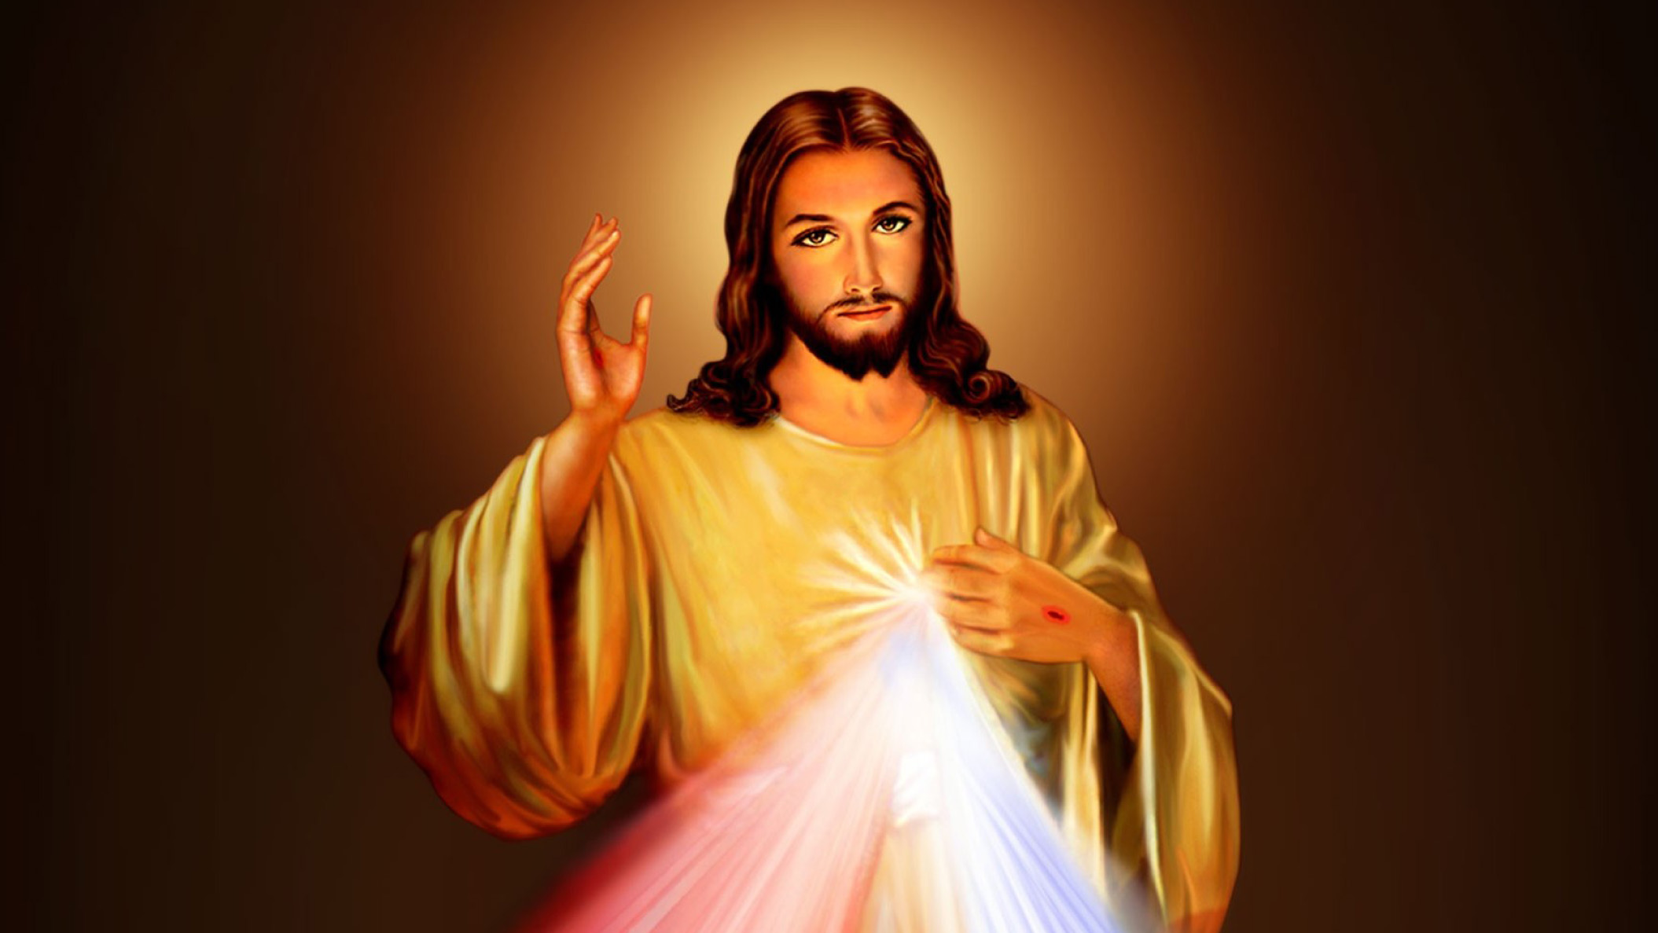

Slide 44
Light of the world
You stepped down into darkness
Opened my eyes, let me see
Beauty that made this heart adore You
Hope of a life spent with You

Slide 45
Here I am to worship
Here I am to bow down
Here I am to say that You're my God
You're altogether lovely
Altogether worthy
Altogether wonderful to me

Slide 46
King of all days
Oh, so highly exalted
Glorious in heaven above
Humbly You came to the earth You created
All for love's sake became poor

Slide 47
Here I am to worship
Here I am to bow down
Here I am to say that You're my God
You're altogether lovely
Altogether worthy
Altogether wonderful to me

Slide 48
I'll never know how much it cost
To see my sin upon that cross
(4x)

Slide 49
Here I am to worship
Here I am to bow down
Here I am to say that You're my God
You're altogether lovely
Altogether worthy
Altogether wonderful to me

Slide 51

Verse 1
Jesus, my only desire.
Jesus, my only desire.
Jesus, my love;
Jesus, my beauty.
Jesus, my God and my all!

Slide 53
Verse 1
Jesus, my only desire.
Jesus, my only desire.
Jesus, my love;
Jesus, my beauty.
Jesus, my God and my all!

Slide 54
Verse 1
Jesus, mi unico anhelo.
Jesus, mi unico anhelo.
Jesus, mi amor.
Jesus, mi bellaza.
Jesus, mi Dios y mi todo.

Slide 55
Verse 2
Jesus, the hope of my soul.
Jesus, the hope of my soul.
Jesus, my strength;
Jesus, my refuge.
Jesus, my God and my all!

Slide 56
Verse 2
Jesús, confianza del alma.
Jesús, confianza del alma.
Jesús, mi poder.
Jesús, mi refugio.
Jesús, mi Dios y mi todo.

Slide 57
Verse 3
Jesus, the mercy of God.
Jesus, the mercy of God.
Jesus, my truth;
Jesus, my justice.
Jesus, my God and my all!

Slide 58
Verse 3
Jesús, piedad del Señor.
Jesús, piedad del Señor.
Jesús, mi verdad.
Jesús, mi justicia.
Jesús, mi Dios y mi todo.

Slide 59
Verse 4
Jesus, my life giving Lord.
Jesus, my life giving Lord.
Jesus, my joy;
Jesus, my glory.
Jesus, my God and my all!

Slide 60
Verse 4
Jesús, mi dulce consuelo.
Jesús, mi dulce consuelo.
Jesús, tierna paz.
Jesús, mi alegria.
Jesús, mi Dios y mi todo.

Slide 61
Verse 5
Jesus, the wisdom of God.
Jesus, the wisdom of God.
Jesus, my light;
Jesus, my vision.
Jesus, my God and my all!

Slide 62
Verse 5
Jesús, mi lám para y luz.
Jesús, mi lám para y luz.
Jesús, mi saber.
Jesús, mi destino.
Jesús, mi Dios y mi todo.

Slide 64
Pan de vida, cuerpo del Señor
Cup of blessing,
blood of Christ the Lord
At this table the last shall be first
Poder es servir,
porque Dios es amor

Slide 65
We are the dwelling of God
Fragile and wounded and weak
We are the body of Christ
Called to be the
compassion of God

Slide 66
Pan de vida, cuerpo del Señor
Cup of blessing,
blood of Christ the Lord
At this table the last shall be first
Poder es servir,
porque Dios es amor

Slide 67
Ustedes me llaman "Señor"
Me inclino a lavarles los pies
Hagan lo mismo, humildes
Sirviendo los unos a otros

Slide 68
Pan de vida, cuerpo del Señor
Cup of blessing,
blood of Christ the Lord
At this table the last shall be first
Poder es servir,
porque Dios es amor

Slide 69
There is no Jew or Greek
There is no slave or free
There is no woman or man
Only heirs of the promise of God

Slide 70
Pan de vida, cuerpo del Señor
Cup of blessing,
blood of Christ the Lord
At this table the last shall be first
Poder es servir,
porque Dios es amor

Slide 72
The perfect wisdom of our God
Revealed in all the universe:
All things created by His hand
And held together at His command.
He knows the mysteries of the seas,
The secrets of the stars are His;
He guides the planets on their way
And turns the earth through
another day.

Slide 73
Perfecto y sabio eres dios,
Perfecta es tu creación:
To firme y dulce vos habló
y él universo creado fue.
Conoces el profundo mar,
La estrella mas lejos de mi
Di día y noche tengo en ti,
Seguridad en mi vida aquí.

Slide 74
The matchless wisdom of His ways
That mark the path of righteousness;
His word a lamp unto my feet,
His Spirit teaching and guiding me.
And O the mystery of the cross,
That God should suffer for the lost,
So that the fool might shame the wise,
And all the glory might go to Christ!

Slide 75
Perfecto tu camino es,
y tu justicia me guiará,
Mi luz es tu palabra fiel,
Me alumbrará en la oscuridad.
El gran misterio de la cruz,
Del inocente que murió.
Jesus por mi su vida dio,
La gloria es para ti Señor.

Slide 76
O grant me wisdom from above,
To pray for peace and cling to love,
And teach me humbly to receive
The sun and rain of Your sovereignty.
Each strand of sorrow has a place
Within this tapestry of grace;
So through the trials I choose to say:
“Your perfect will in Your perfect way.”

Slide 77
Sabiduría busco en ti,
Te necesito mi Señor,
Y enséñame con humildad
A comprender tu perfecto plan.
En cada prueba de dolor,
Yo pueda verte mi Señor.
Tu gracia no se acabará,
Pues es perfecta tu voluntad.

Slide 78
En cada prueba de dolor,
Yo pueda verte mi Señor.
Tu gracia no se acabará,
Pues es perfecta tu voluntad.

Slide 80
TANTUM ergo Sacramentum
DOWN in adoration falling,
Veneremur cernui:
Lo! the sacred Host we hail,
Et antiquum documentum
Lo! oe'r ancient forms departing
Novo cedat ritui:
Newer rites of grace prevail;
Praestet fides supplementum
Faith for all defects supplying,
Sensuum defectui.
Where the feeble senses fail.

Slide 81
Genitori, Genitoque
To the everlasting Father,
Laus et iubilatio,
And the Son Who reigns on high
Salus, honor, virtus quoque
With the Holy Spirit proceeding
Sit et benedictio:
Forth from each eternally,
Procedenti ab utroque
Be salvation, honor blessing,
Compar sit laudatio.
Might and endless majesty.
Amen.

Slide 83
Holy God, we praise thy name;
Lord of all, we bow before thee;
All on earth they scepter claim;
All in heaven above adore thee. Infinite they vast domain,
Everlasting is thy reign!

Slide 84
Hark, the loud celestial hymn;
Angel choirs above are raising; Cherubim and Seraphim,
In unceasing chorus praising,
Fill the heavens with sweet accord: "Holy, holy, holy, Lord!"

Slide 85
