Slide 1
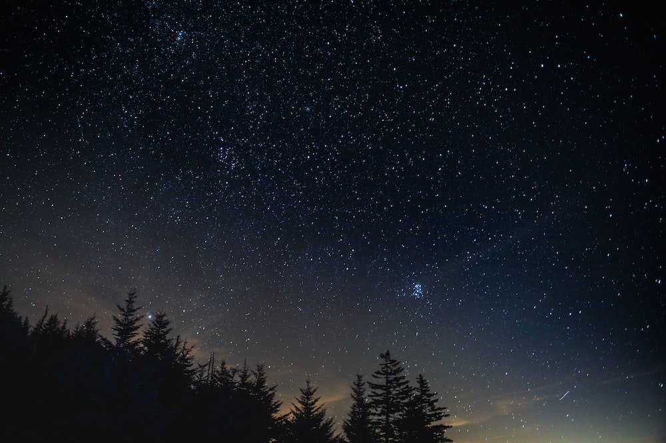
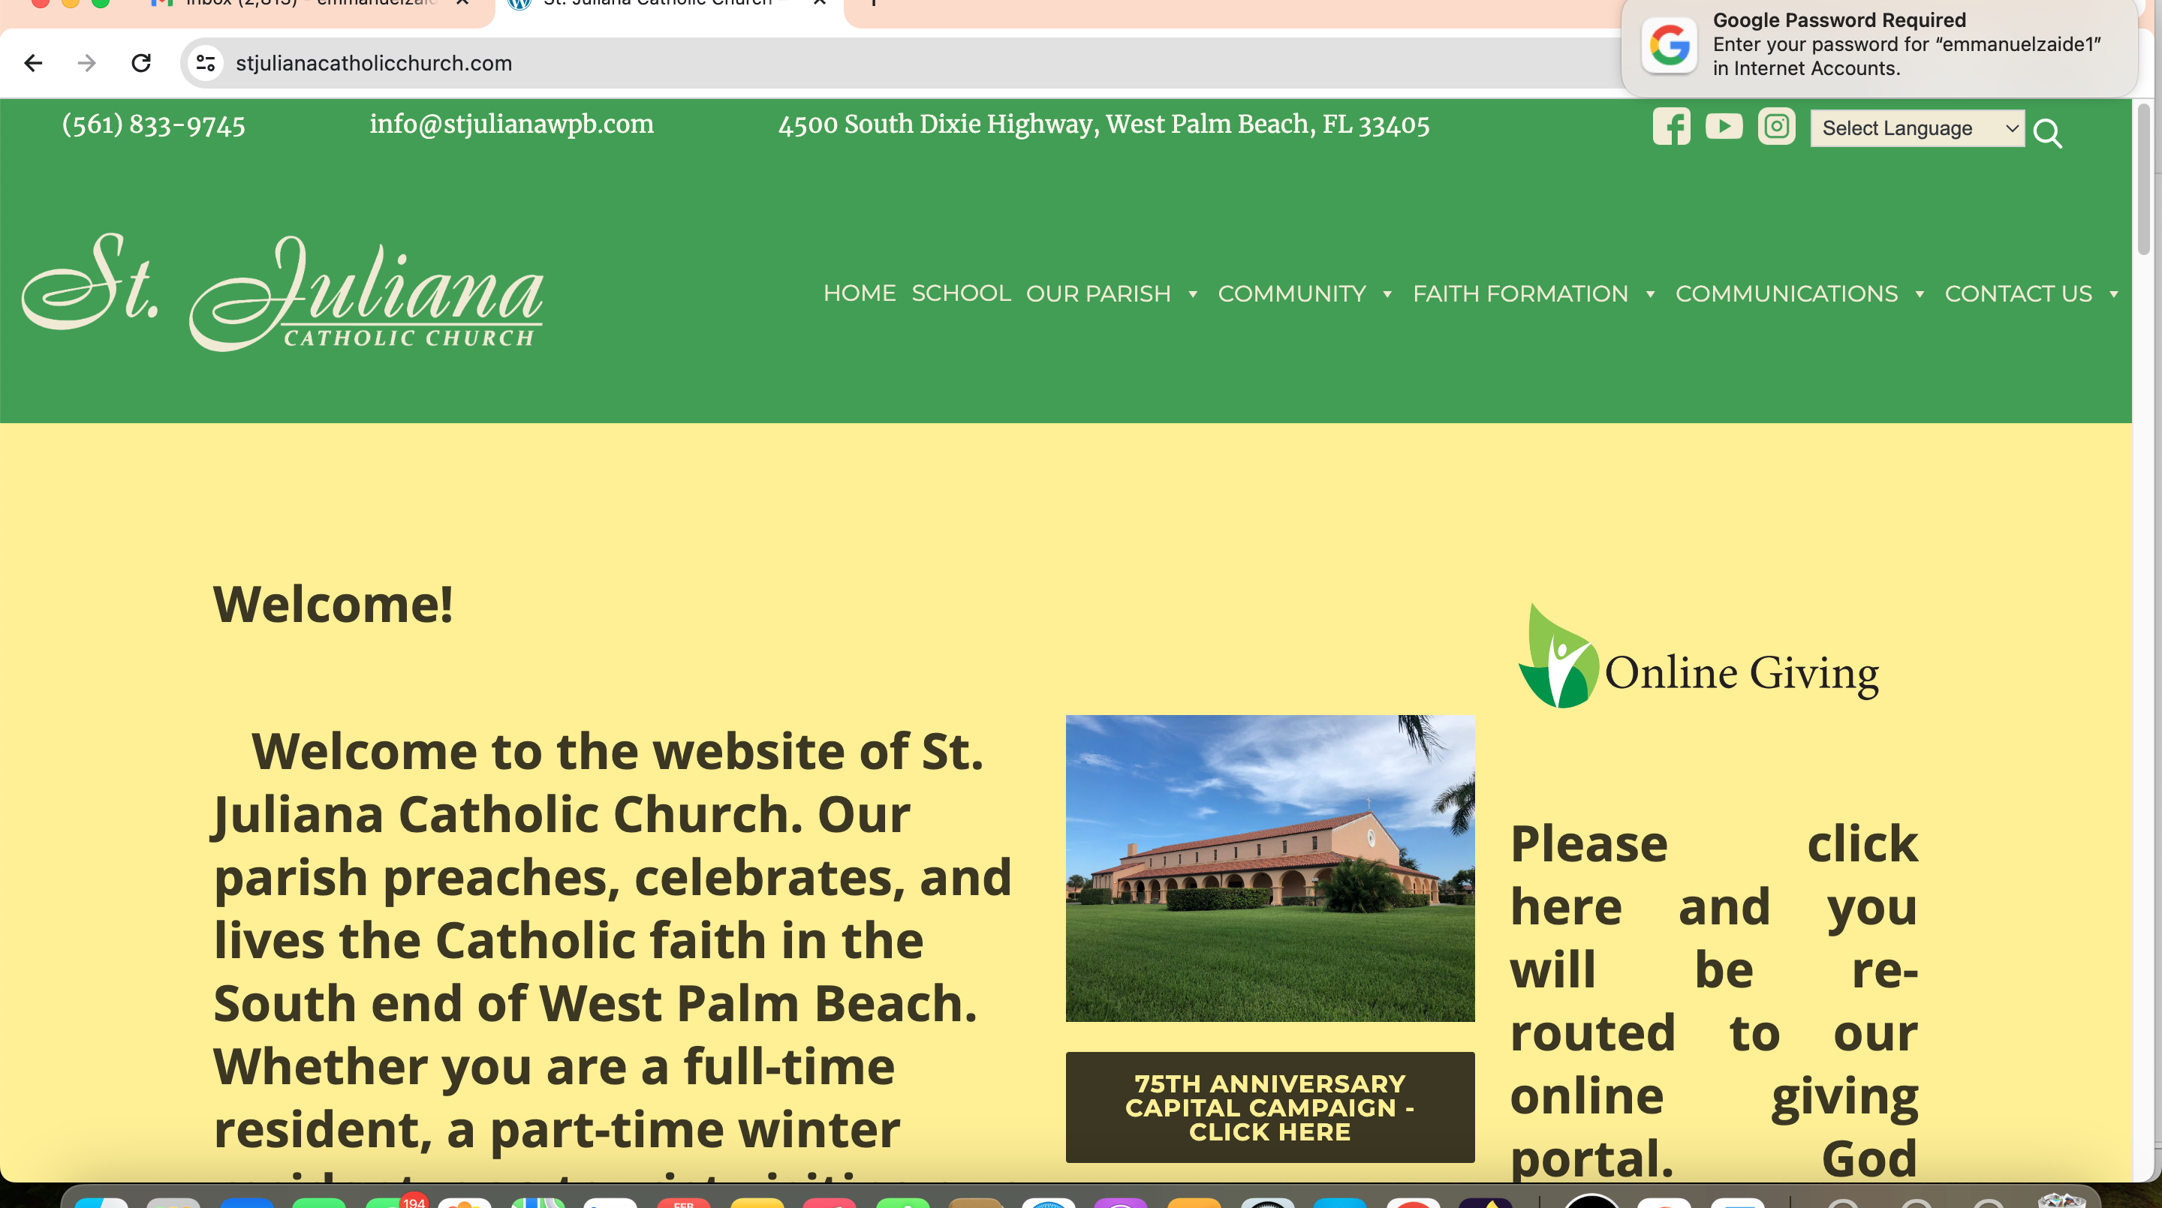
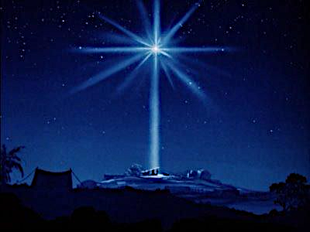
The Nativity of The Lord
Christmas
Vigil Holy Mass
Dec. 24, 2024

Slide 2
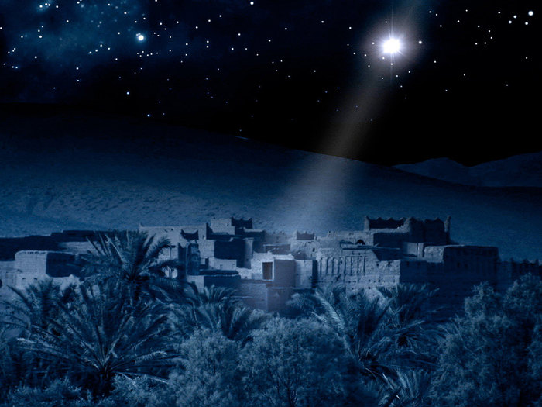

Slide 3

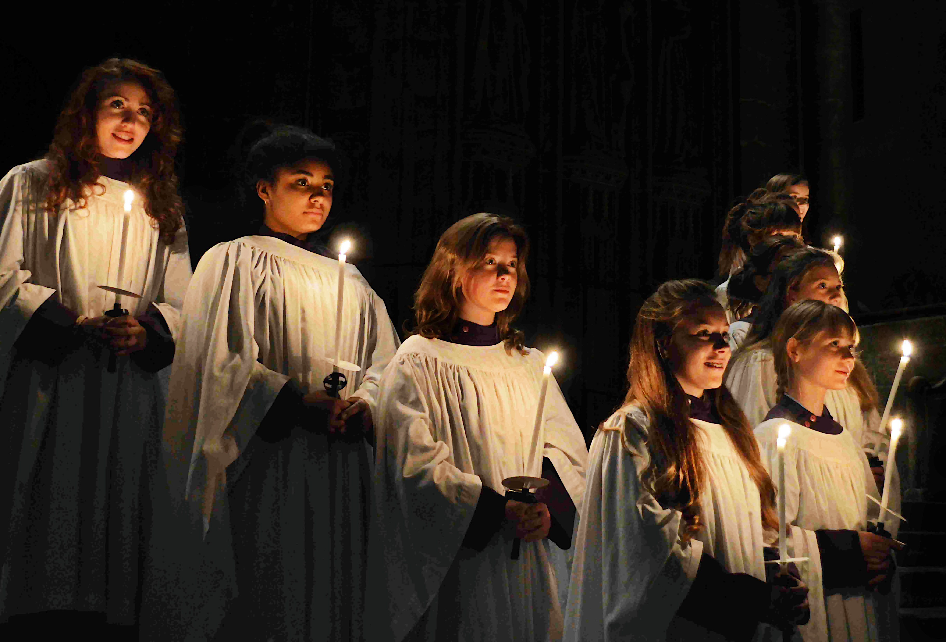
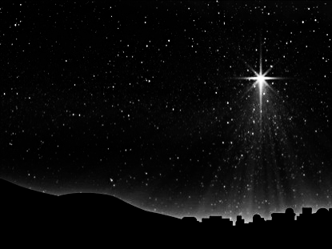

Entrance Hymn
O
O Come,
All Ye Faithful
Arr. By David Willocks

Slide 4
Entrance Hymn
O Come All Ye Faithful
Verse 1
O come, all ye faithful,
joyful and triumphant
O come ye, o come ye to Bethlehem
Come and behold Him,
born the King of Angels

Slide 5
Entrance Hymn
O Come All Ye Faithful
Refrain
O come, let us adore Him
O come, let us adore Him
O come, let us adore Him
Christ the Lord

Slide 6
Entrance Hymn
O Come All Ye Faithful
Verse 2
True God from true God,
Light from Light eternal,
behold, He comes forth from
the Virgin’s womb,
Son of God, begotten, not created

Slide 7
Entrance Hymn
O Come All Ye Faithful
Refrain
O come, let us adore Him
O come, let us adore Him
O come, let us adore Him
Christ the Lord

Slide 8
Entrance Hymn
O Come All Ye Faithful
Verse 6
Sing, choirs of angels
Sing in exultation
Sing, all ye citizens of heav'n above!
Glory in the highest

Slide 9
Entrance Hymn
O Come All Ye Faithful
Refrain
O come, let us adore Him
O come, let us adore Him
O come, let us adore Him
Christ the Lord

Slide 10
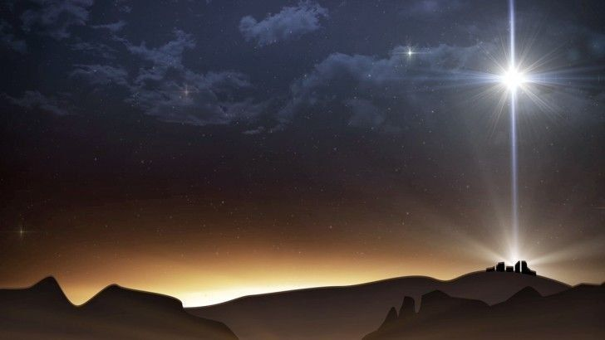
Verse 7
Yea, Lord, we greet thee,
Born this happy morning;
Jesus, to thee be glory giv’n!
Word of the Father,
Now in flesh appearing!

Slide 11
Refrain
O come, let us adore Him
O come, let us adore Him
O come, let us adore Him
Christ the Lord

Slide 12
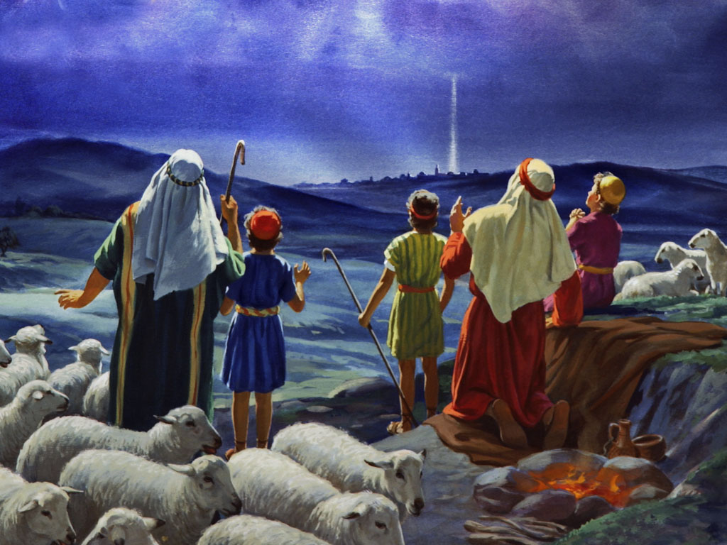

Slide 13
Glory! Glory to God in
the highest,
Glory! Glory to God in
the highest,
And on earth peace
to people of good will.
GLORY TO GOD

Slide 14
We praise You, we bless You,
we adore You, we glorify You,
we give You thanks
for Your great glory.
Lord God Heavenly King.
O God, Almighty Father.
Photo by Kumiko SHIMIZU on Unsplash
GLORY TO GOD

Slide 15
Lord Jesus Christ, Only Begotten Son
Lord God, Lamb of God,
Son of the Father,
You take away the sins of the world,
have mercy on us;
You take away the sins of the world.,
receive our prayer;
GLORY TO GOD

Slide 16
You are seated at
the right hand of the Father,
have mercy on us.
GLORY TO GOD

Slide 17
For you alone are the Holy One,
You alone are the Lord,
You alone are the Most High,
Jesus Christ,
with the Holy Spirit,
in the glory of God the Father
GLORY TO GOD

Slide 18
Glory! Glory to God in the highest,
Glory! Glory to God in the highest, and on earth
peace to people
of good will. Amen.
GLORY TO GOD

Slide 19
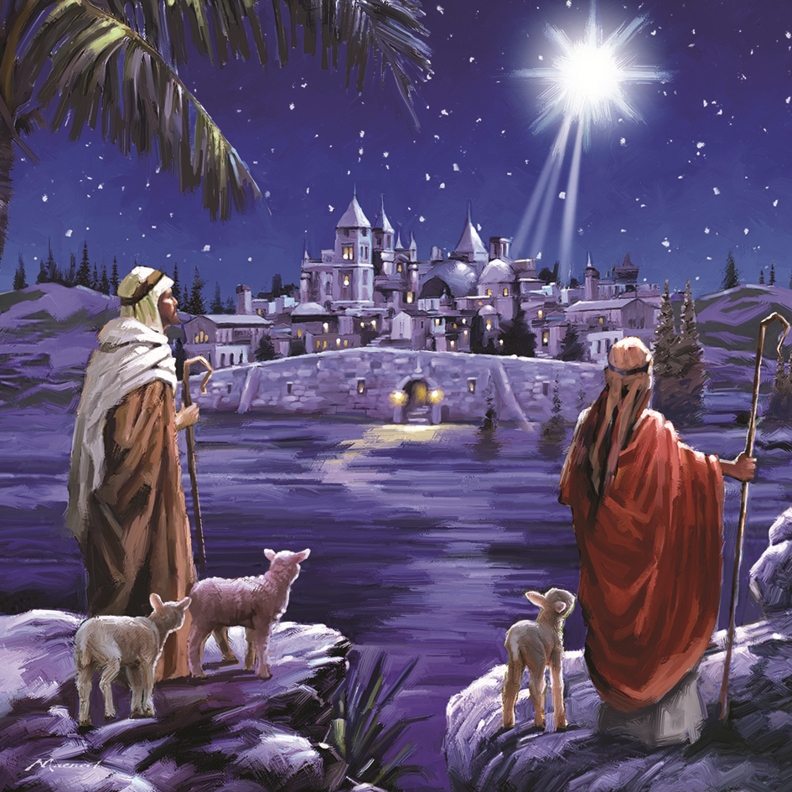

Slide 20
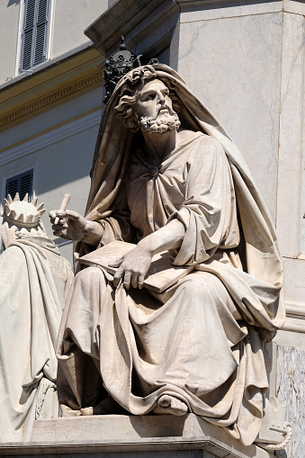
First Reading
Isaiah
62: 1-5

Slide 21
Entrance Hymn
O Come All Ye Faithful
First Reading
For Zion’s sake
I will not be silent,
for Jerusalem’s sake
I will not be quiet,
until her vindication shines forth like the dawn and her victory like a burning torch.

Slide 22
Entrance Hymn
O Come All Ye Faithful
First Reading
Nations shall behold
Your vindication,
and all the kings
Your glory; You shall be called by a new name pronounced by the mouth of the LORD.

Slide 23
Entrance Hymn
O Come All Ye Faithful
First Reading
You shall be a
glorious crown in
the hand of the LORD,
a royal diadem held by Your God.

Slide 24
Entrance Hymn
O Come All Ye Faithful
First Reading
No more shall people
call you “Forsaken,”
or your land “Desolate,”
but you shall be called
“My Delight,”
and your land “Espoused.”

Slide 25
Entrance Hymn
O Come All Ye Faithful
First Reading
For the LORD delights
in you and makes
your land his spouse.

Slide 26
Entrance Hymn
O Come All Ye Faithful
First Reading
As a young man
marries a virgin,
Your Builder shall marry you;
and as a bridegroom rejoices in his bride so shall your God
rejoice in you.

Slide 27
The Word of The Lord
Thanks be to God

Slide 28
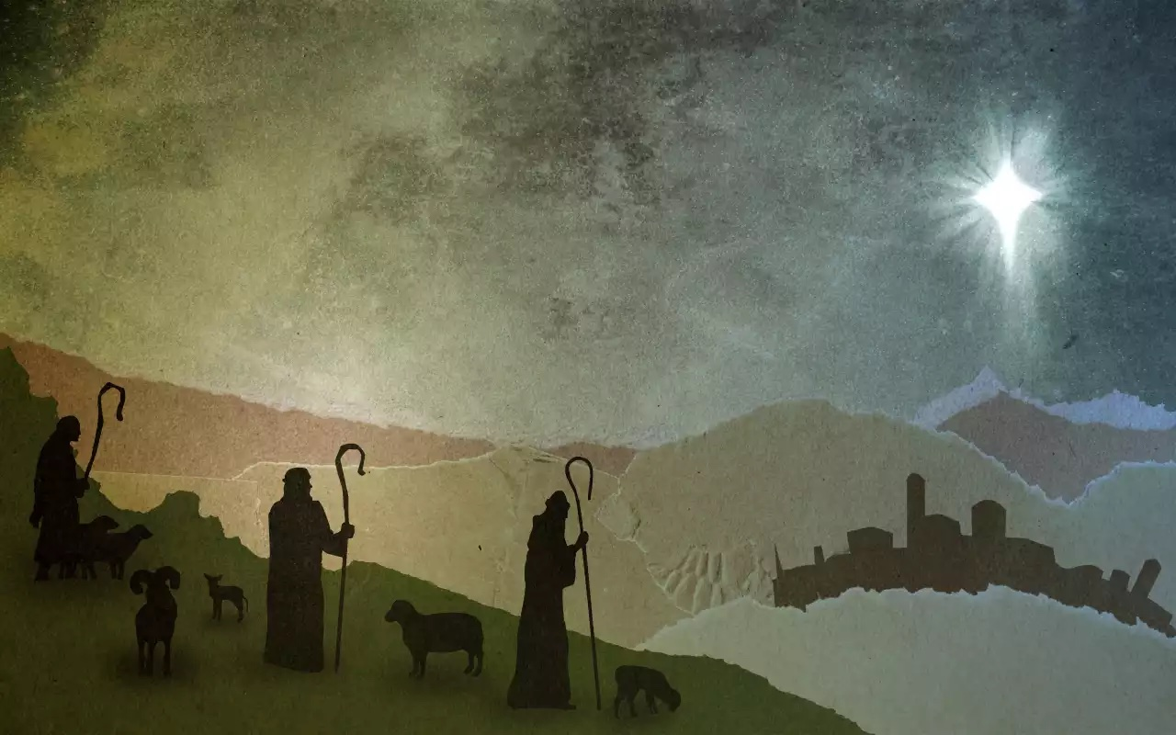

Slide 29
Responsorial Psalm
Ps 89:4-5, 16-17, 27, 29
Cantor:
For ever I will sing the goodness of the Lord.

Slide 30
Responsorial Psalm
Ps 89:4-5, 16-17, 27, 29
Response:
For ever I will sing the goodness of the Lord.

Slide 31
1. I have made a covenant with my chosen one, I have sworn to David
my servant:
Forever will I confirm your posterity and establish Your throne for all generations.

Slide 32
Responsorial Psalm
Ps 89:4-5, 16-17, 27, 29
Response:
For ever I will sing the goodness of the Lord.

Slide 33
2. Blessed the people who know the joyful shout; in the light of Your countenance,
O LORD, they walk.
At Your Name they rejoice all the day, and through Your justice
they are exalted.
Responsorial Psalm

Slide 34
Responsorial Psalm
Ps 89:4-5, 16-17, 27, 29
Response:
For ever I will sing the goodness of the Lord.

Slide 35
3. He shall say of me,
“You are my father,
my God, the Rock, my Savior.”
Forever I will maintain my
kindness toward Him,
and my covenant with Him stands firm.
Responsorial Psalm

Slide 36
Responsorial Psalm
Ps 89:4-5, 16-17, 27, 29
Response:
For ever I will sing the goodness of the Lord.

Slide 37
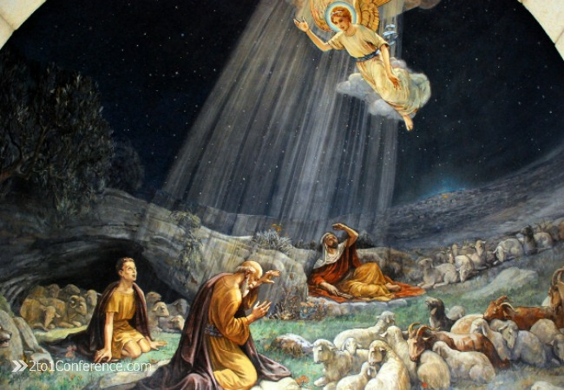

Slide 38
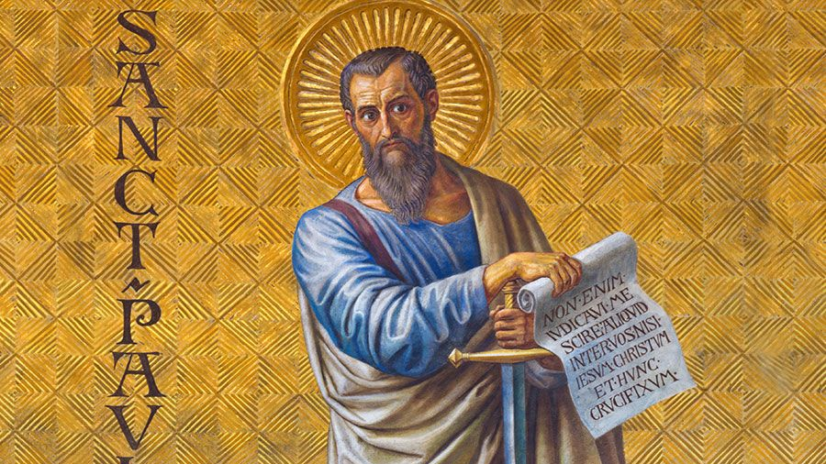
Second Reading: Acts 13:16-17, 22-25

Slide 39
Entrance Hymn
O Come All Ye Faithful
Second Reading
When Paul reached
Antioch in Pisidia and
entered the synagogue,
he stood up, motioned
with his hand, and said,
“Fellow Israelites and you others who are God-fearing, listen.

Slide 40
Entrance Hymn
O Come All Ye Faithful
Second Reading
The God of this people
Israel chose our ancestors
and exalted the people during their sojourn in the
land of Egypt.
With uplifted arm
He led them out of it

Slide 41
Entrance Hymn
O Come All Ye Faithful
First Reading
Then he removed Saul
and raised up David as
king; of him he testified,
‘I have found David, son of Jesse, a man after my own heart; he will carry out my every wish.’

Slide 42
Entrance Hymn
O Come All Ye Faithful
Second Reading
From this man’s
descendants God,
according to His promise,
has brought to Israel a Savior, Jesus.
John heralded His coming by proclaiming a baptism of repentance to all the people of Israel;

Slide 43
Entrance Hymn
O Come All Ye Faithful
Second Reading
and as John was
completing his course,
he would say,
‘What do you suppose that I am?
I am not He.
Behold, one is coming after me;
I am not worthy to unfasten the sandals of His feet.’”

Slide 44
The Word of the Lord Thanks be to God

Slide 45
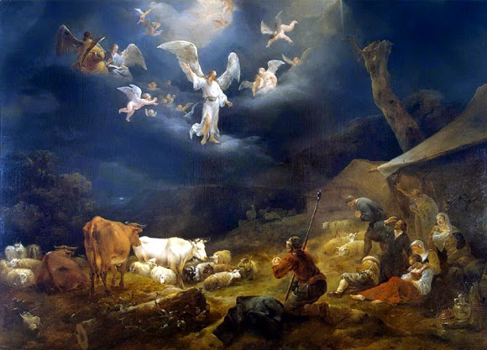

Slide 46
Alleluia, Alleluia, Alleluia.
Alleluia, Alleluia, Alleluia.
Tomorrow the wickedness of the
earth will be destroyed: the Savior
of the world will reign over us.
R. Alleluia, alleluia, Alleluia.
Alleluia, alleluia, Alleluia.
Alleluia

Slide 47
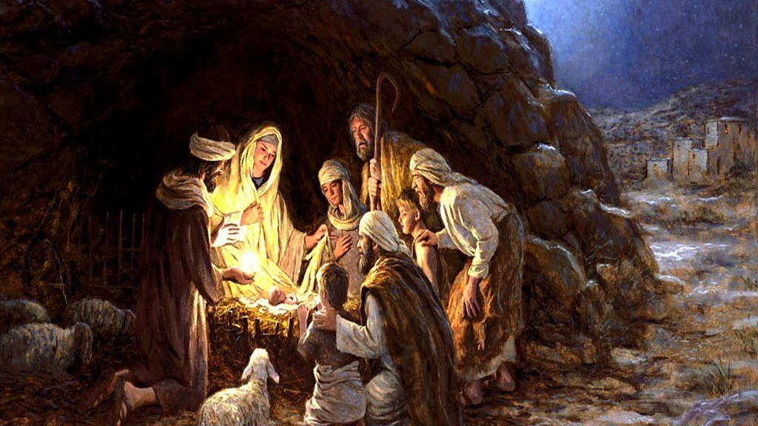

Slide 48
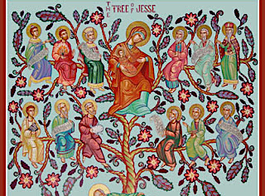
The Gospel Matthew 1:1-25

Slide 49
Entrance Hymn
O Come All Ye Faithful
The book of the
genealogy of Jesus Christ,
the son of David, the son
of Abraham.
Abraham became the father of Isaac,
Isaac the father of Jacob,
Jacob the father of Judah and
his brothers.
Gospel Reading

Slide 50
Entrance Hymn
O Come All Ye Faithful
Gospel Reading
Judah became the
father of Perez and Zerah,
whose mother was Tamar.
Perez became the father of Hezron,
Hezron the father of Ram,
Ram the father of Amminadab.

Slide 51
Entrance Hymn
O Come All Ye Faithful
Gospel Reading
Amminadab became
the father of Nahshon,
Nahshon the father of Salmon,
Salmon the father of Boaz,
whose mother was Rahab.

Slide 52
Entrance Hymn
O Come All Ye Faithful
Gospel Reading
Boaz became the father
of Obed, whose mother was Ruth.
Obed became the father of Jesse,
Jesse the father of David the king.

Slide 53
Entrance Hymn
O Come All Ye Faithful
Gospel Reading
David became the
father of Solomon,
whose mother had been the wife of Uriah. Solomon became
the father of Rehoboam,
Rehoboam the father of Abijah,

Slide 54
Entrance Hymn
O Come All Ye Faithful
Gospel Reading
Abijah the father of
Asaph. Asaph became
the father of Jehoshaphat,
Jehoshaphat the father of Joram,
Joram the father of Uzziah.

Slide 55
Entrance Hymn
O Come All Ye Faithful
Gospel Reading
Uzziah became the
father of Jotham,
Jotham the father of Ahaz,
Ahaz the father of Hezekiah.
Hezekiah became the
father of Manasseh,
Manasseh the father of Amos,

Slide 56
Entrance Hymn
O Come All Ye Faithful
Gospel Reading
Amos the father of Josiah.
Josiah became the father of
Jechoniah and his brothers
at the time of the
Babylonian exile.

Slide 57
Entrance Hymn
O Come All Ye Faithful
Gospel Reading
After the Babylonian
exile, Jechoniah became
the father of Shealtiel,
Shealtiel the father
of Zerubbabel,
Zerubbabel the father
of Abiud.

Slide 58
Entrance Hymn
O Come All Ye Faithful
Gospel Reading
Abiud became the father
of Eliakim,
Eliakim the father of Azor,
Azor the father of Zadok.
Zadok became the father
of Achim,

Slide 59
Entrance Hymn
O Come All Ye Faithful
Gospel Reading
Achim the father of Eliud,
Eliud the father of Eleazar.
Eleazar became the father
of Matthan,
Matthan the father of Jacob,

Slide 60
Entrance Hymn
O Come All Ye Faithful
Gospel Reading
Jacob the father of
Joseph, the husband of
Mary. Of her was born
Jesus who is called the Christ.
Thus the total number
of generations
from Abraham to David
is fourteen generations;

Slide 61
Entrance Hymn
O Come All Ye Faithful
Gospel Reading
from David to the
Babylonian exile,
fourteen generations;
from the Babylonian exile
to the Christ,
fourteen generations.

Slide 62
Entrance Hymn
O Come All Ye Faithful
Gospel Reading
Now this is how the birth
of Jesus Christ came about.
When his mother Mary was betrothed to Joseph,
but before they lived together,
she was found with child through the Holy Spirit.

Slide 63
Entrance Hymn
O Come All Ye Faithful
Gospel Reading
Joseph her husband,
since he was a righteous
man, yet unwilling to expose her to shame, decided to divorce her quietly.

Slide 64
Entrance Hymn
O Come All Ye Faithful
Gospel Reading
Such was his intention
when, behold,
the angel of the Lord
appeared to him in a dream and said,
“Joseph, son of David,
do not be afraid to take Mary
your wife into your home.

Slide 65
Entrance Hymn
O Come All Ye Faithful
Gospel Reading
For it is through the Holy
Spirit that this child has been
conceived in her.
She will bear a son and you
are to name him Jesus,
because he will save his people
from their sins.”

Slide 66
Entrance Hymn
O Come All Ye Faithful
Gospel Reading
All this took place to
Fulfill what the Lord had
said through the prophet:
Behold, the virgin shall conceive
and bear a son,
and they shall name him Emmanuel,
which means “God is with us.”

Slide 67
Entrance Hymn
O Come All Ye Faithful
Gospel Reading
When Joseph awoke,
he did as the angel of
the Lord had commanded him
and took his wife into his home.
He had no relations with her until she bore a son,
and he named him Jesus.

Slide 68
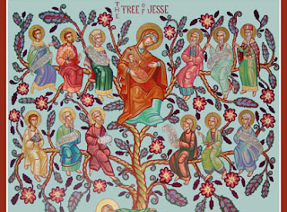
The Gospel of the Lord Praise to You, Lord Jesus

Slide 70
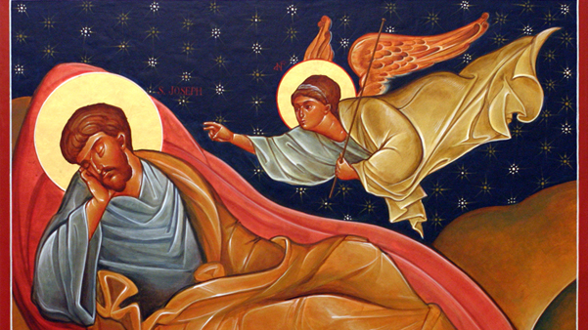
Gospel Matthew 1: 18-25

Slide 71
Gospel
This is how the birth of
Jesus Christ came about.
When his mother Mary
was betrothed to Joseph,
but before they lived together,
she was found with child
through the Holy Spirit.

Slide 72
Gospel
Joseph her husband,
since he was a righteous man,
yet unwilling to expose her to shame, decided to divorce
her quietly.

Slide 73
Gospel
Such was his intention
when, behold, the angel of the Lord appeared to him
in a dream and said,
"Joseph, son of David,
do not be afraid to take Mary
your wife into your home.

Slide 74
Gospel
For it is through the Holy Spirit
that this child has been conceived in her.
She will bear a son and
you are to name Him Jesus,
because He will save His people
from their sins."

Slide 75
Gospel
All this took place to fulfill what the Lord had said through the prophet:
Behold, the virgin shall conceive
and bear a son, and they shall name Him Emmanuel,
which means "God is with us."

Slide 76
Gospel
When Joseph awoke,
he did as the angel of the Lord had commanded him
and took his wife into his home. He had no relations with her
until she bore a son,
and he named Him Jesus.

Slide 77
The Gospel
of the Lord
Praise to You, Lord Jesus Christ

Slide 78
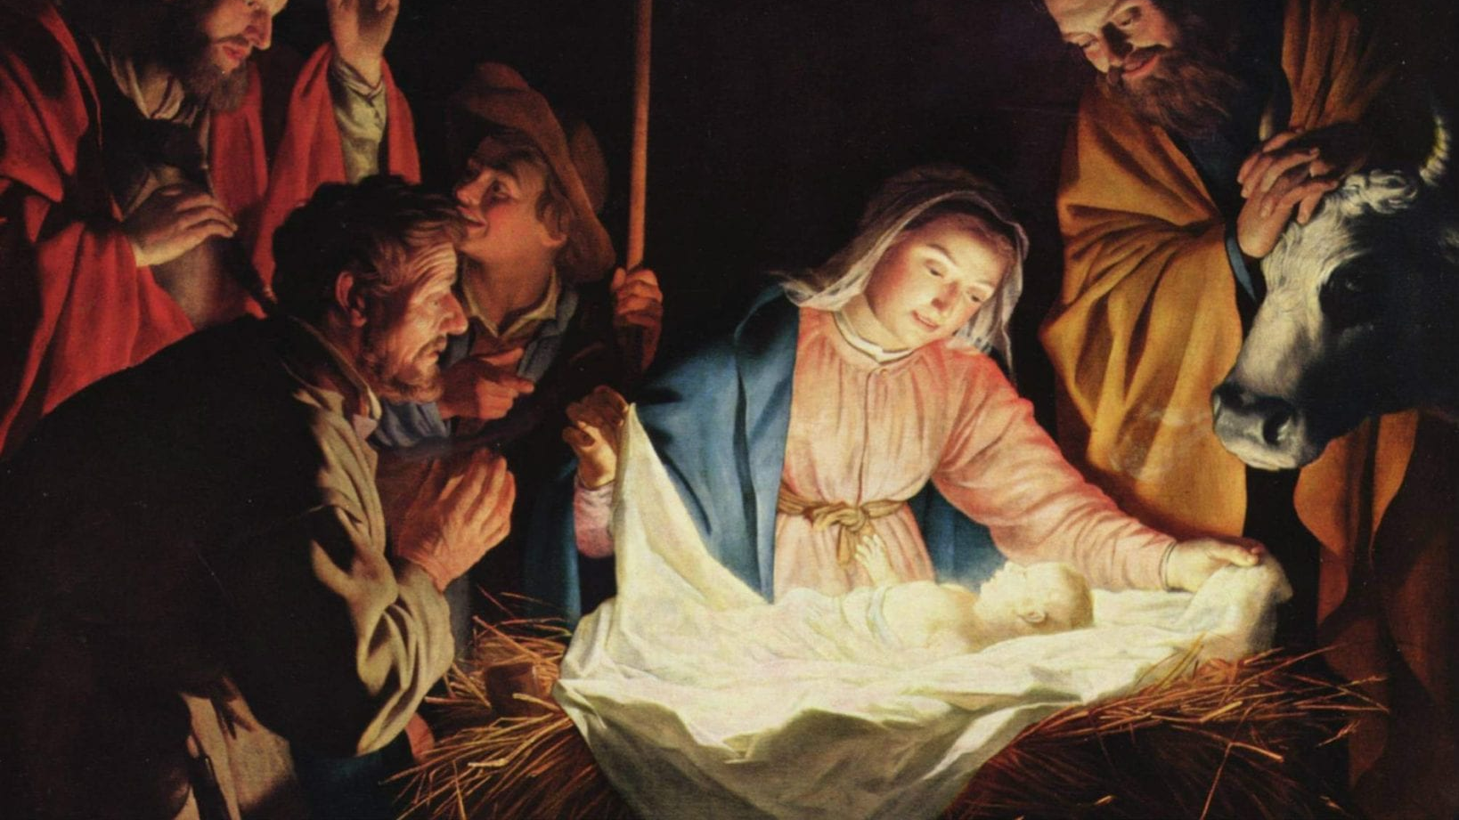

Slide 79
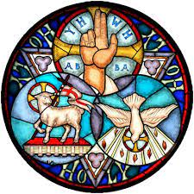
Nicene Creed
I believe in one God, the Father almighty, maker of heaven and earth, of all things visible and invisible.

Slide 80
Nicene Creed
I believe in one Lord Jesus Christ, the Only Begotten
Son of God, born of the Father before
all ages.

Slide 81
Nicene Creed
God from God, Light from Light, true God from true God, begotten, not made, consubstantial with the Father; through Him all things
were made.

Slide 82
Nicene Creed
For us men and for our salvation He came down from heaven,
PLEASE BOW
and by the Holy Spirit was incarnate of the Virgin Mary, and became man.

Slide 83
Nicene Creed
For our sake He was
crucified under Pontius Pilate, He suffered death and was buried, and rose again on the third day in accordance with the Scriptures.

Slide 84
Nicene Creed
He ascended into heaven and is seated at the right hand of the Father. He will come again in glory to judge the living and the dead and His kingdom will have no end.

Slide 85
Nicene Creed
I believe in the Holy Spirit, the Lord, the giver of life, who proceeds from the Father and the Son, who with the Father and the Son is adored and glorified,
who has spoken through
the prophets.

Slide 86
Nicene Creed
I believe in one, holy catholic and apostolic Church. I confess one Baptism for the forgiveness of sins and I look forward to the resurrection of the dead and the life of the world to come. Amen

Slide 87
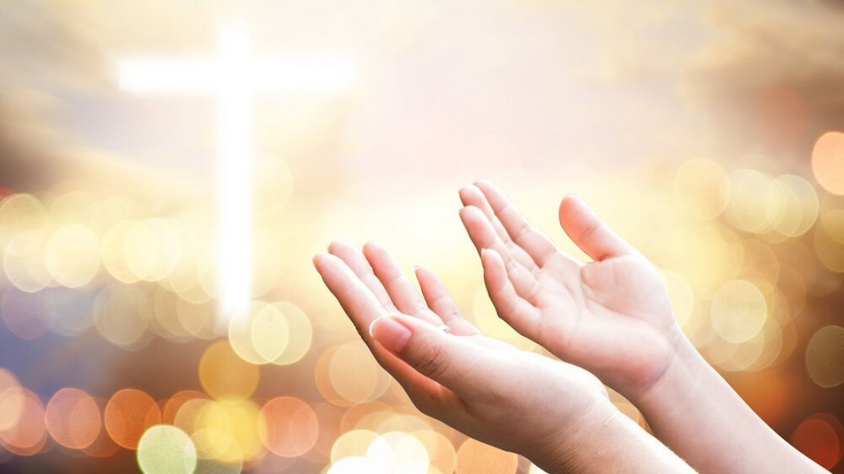
Prayers of the Faithful
Lord, Hear our prayer.

Slide 89
Offertory Hymn
O
Away in the Manger
By William J. Kirkpatrick
Arr. By Ola Gjielo

Slide 90
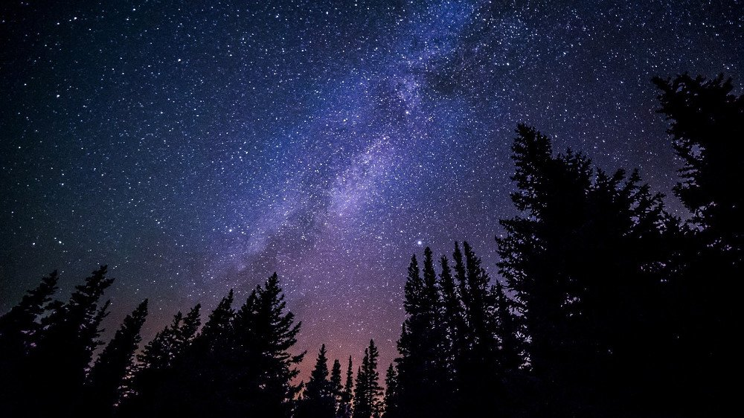
Verse 1
Away in a manger,
no crib for a bed,
the little Lord Jesus
laid down His sweet head;
The stars in the bright sky
looked down where He lay,
The little Lord Jesus asleep on the hay.

Slide 91
Verse 2
The cattle are lowing,
The Baby wakes,
but little Lord Jesus,
no crying He makes.
I love Thee, Lord Jesus,
look down from the sky
and stay by my side until morning is nigh.

Slide 92
Verse 3
Be near me, Lord Jesus;
I ask Thee to stay
close by me forever,
And love me, I pray.
Bless all the dear children
in Thy tender care, and take us to heaven, to live with Thee there.

Slide 94
  Preface Acclamation
Holy, Holy, Holy Lord
God of hosts.
Heaven and earth,
are full of Your glory,
Hosanna in the highest

Slide 95
Blessed is He,
who comes,
in the name of
the Lord.
Hosanna in the highest
Hosanna in the highest
  Preface Acclamation

Slide 96
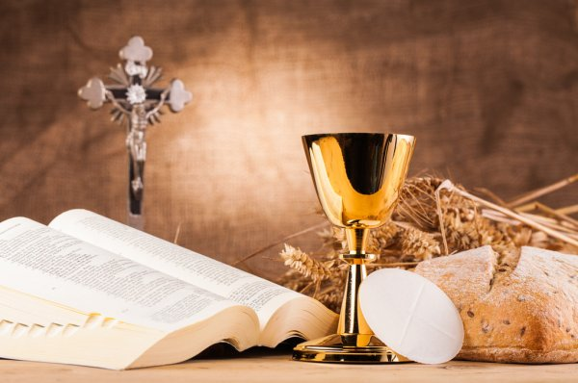

Slide 97
Memorial Acclamation
When we eat this Bread and drink this Cup, we proclaim Your death, O Lord
Until You come again.

Slide 99
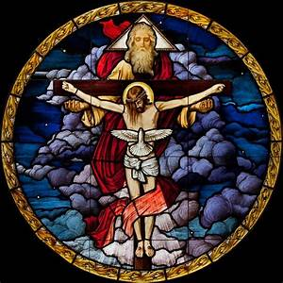
Concluding
Doxology
Amen,
Amen, Amen,
Amen, Amen!
Amen,
Amen, Amen,
Amen, Amen!
Amen,
Amen,
Amen!

Slide 100
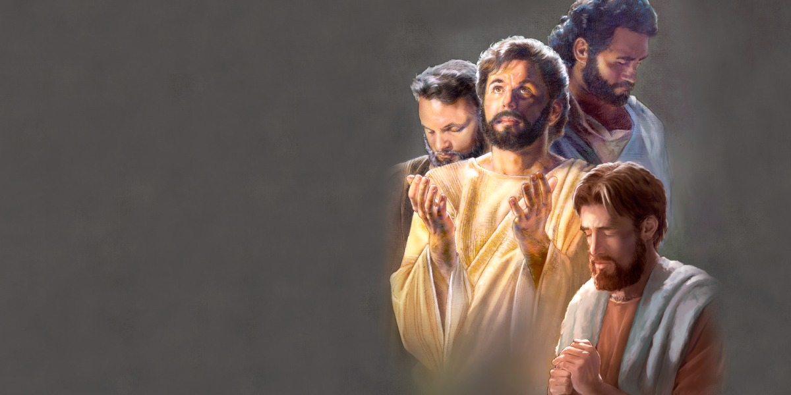
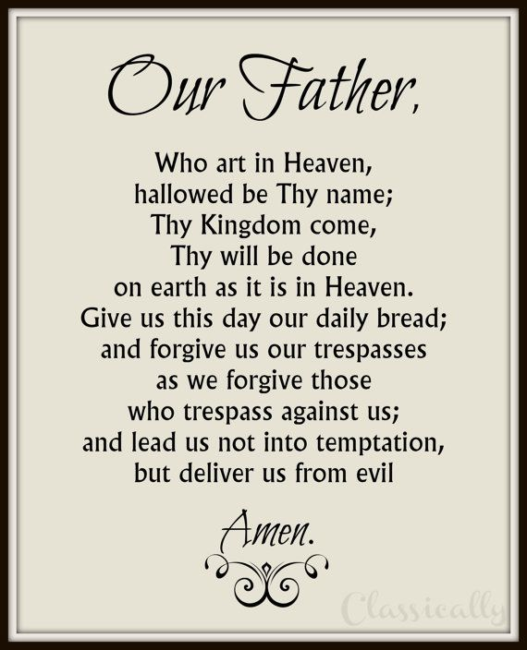
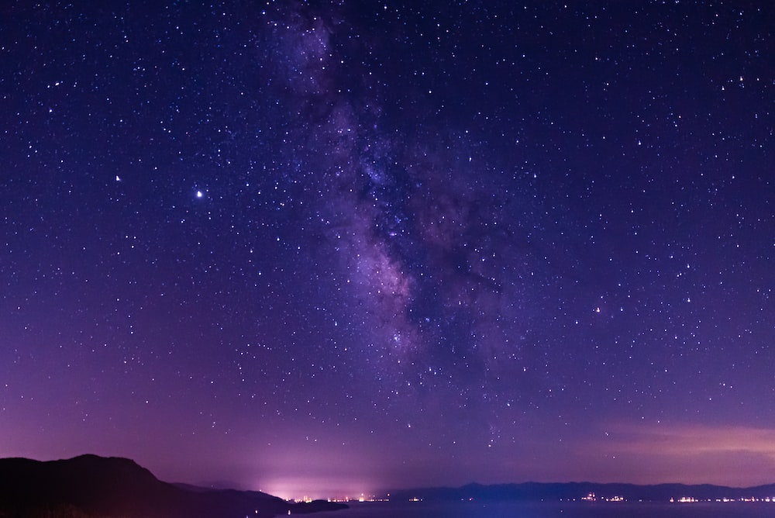
For the kingdom, the power and the glory
are Yours now and forever.
For the kingdom, the power and the glory
are Yours now and forever.

Slide 101


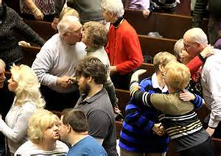
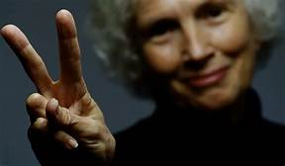
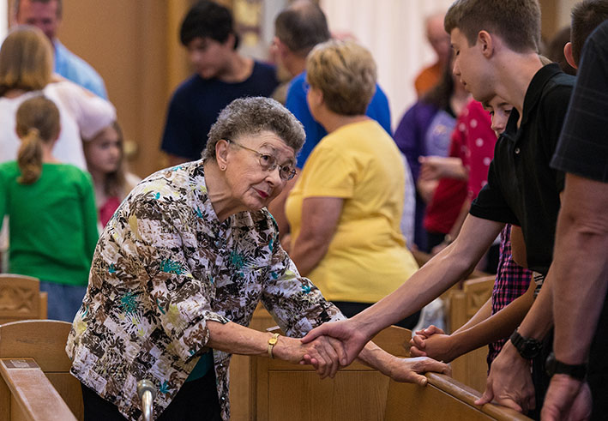

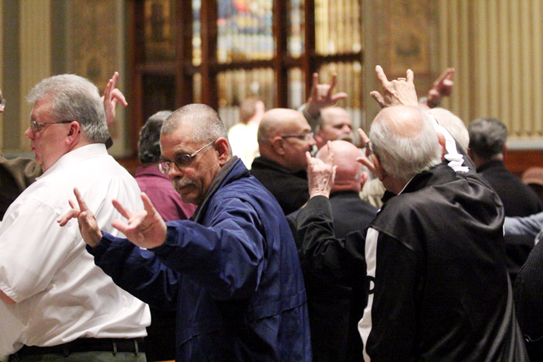
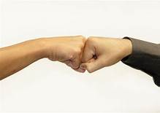
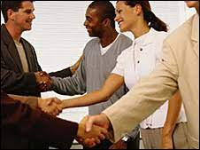
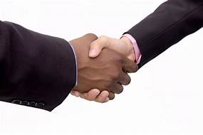

Slide 102
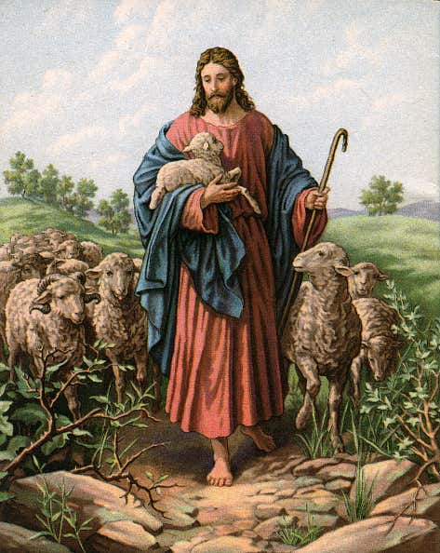
Lamb of God
Lamb of God
You take way the
si-ns of the world,
have mercy,
have mercy on us.

Slide 103
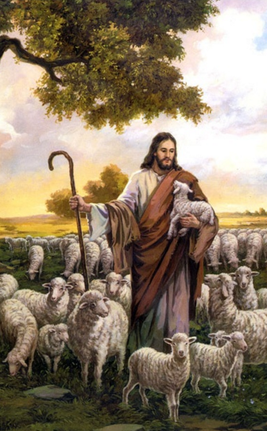
Lamb of God
Lamb of God
You take way the
si-ns of the world,
have mercy,
have mercy on us.

Slide 104
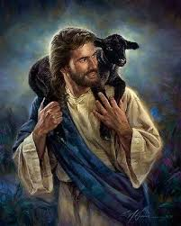
Lamb of God
Lamb of God
You take way the
si-ns of the world,
grant us,
gra-nt u-s peace.

Slide 105
Priest:
Behold the Lamb of God, behold Him who takes away the sins of the world. Blessed are those called to the supper of the Lamb..
All:
Lord I am not worthy that You should enter under my roof, but only say the word and my soul shall be healed.

Slide 107
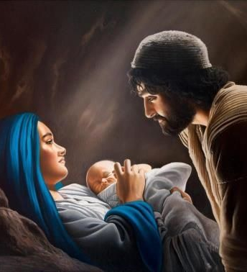
Communion Hymn 1
The First Noel
By W. Sandy
Arr. By Dan Forrest

Slide 108
Verse 1
The first Noel the angel did say
Was to certain poor shepherds
in fields as they lay,
In fields where they lay
keeping their sheep
On a cold winter’s night
that was so deep.

Slide 109
Refrain
Noel, Noel, Noel, Noel!
Born is the King of Israel!

Slide 110
Verse 2
They looked up
and saw a star
Shining in the East beyond them far, And to the earth it gave great light,
And so it continued
both day and night.

Slide 111
Refrain
Noel, Noel, Noel, Noel!
Born is the King of Israel!

Slide 112
Verse 6
Then let us all
With one accord
Sing praises to our Heavenly Lord;
Who with the Father we adore,
And Spirit blest
For ever more.

Slide 113
Refrain
Noel, Noel, Noel, Noel!
Born is the King of Israel!

Slide 115
Communion Hymn 2
He Shall Reign
By Heather Sorenson

Slide 116
Verse 1
In the bleak mid-winter,
all creation groans
For a world in darkness,
frozen like a stone
Light is breaking
In a stable for a throne

Slide 117
And He shall reign
forevermore, forevermore
And He shall reign
forevermore, forevermore
Unto us a child is born
The King of kings and Lord of lords
And He shall reign forevermore, forevermore
Refrain

Slide 118
Verse 2
If I were a wise man,
I would travel far
And if I were a shepherd,
I would do my part
But poor as I am
I will give to Him my heart

Slide 119
And He shall reign forevermore, forevermore
And He shall reign forevermore, forevermore
Unto us a child is born
The King of kings and Lord of lords
And He shall reign forevermore, forevermore
Refrain

Slide 120
Verse 3
Here within a manger lies
The One who made the starry skies
This baby born for sacrifice
Christ, the Messiah
Into our hopes, into our fears
The Savior of the world appears
The promise of eternal years
Christ, the Messiah

Slide 121
He shall reign. (Gloria)
forevermore, forevermore
And He shall reign (Gloria)
forevermore, forevermore
He shall reign
forevermore, forevermore
^He shall reign (Gloria)
forevermore, forevermore
Refrain

Slide 122
Unto us a child is born
The King of kings and Lord of lords
And He shall reign forevermore, forevermore
Refrain

Slide 123
In Excelcis Deo!
He shall reign,
He shall reign,
He shall reign!
(Repeat as needed)
Outro

Slide 125
Communion Hymn 3
Silent Night
Arr. By Dan Forrest

Slide 126
Verse 1
Silent night, holy night
All is calm, all is bright
Round yon Virgin Mother and Child
Holy Infant so tender and mild
Sleep in heavenly peace
Sleep in heavenly peace

Slide 127
Verse 2
Silent night, holy night
Son of God, love's pure light
Radiant beams from Thy holy face
With the dawn of redeeming grace
Jesus Lord, at Thy birth!
Jesus Lord, at Thy birth!

Slide 129
Verse 3
Silent night, holy night
Wondrous Star lend Thy night
With the angels let us sing
“Alleluia” to our King
Christ the Savior is born!
Christ the Savior is born!

Slide 130
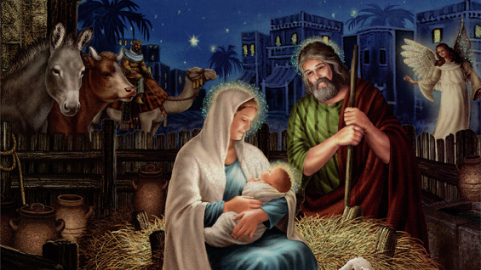

Slide 131

Recessional Hymn
Joy to the World
George F Hanel
1658-1759

Slide 132
Verse 1
Joy to the world, the Lord is come!
Let earth receive her King!
Let every heart prepare Him room,
and heav'n and nature sing,
and heav'n and nature sing,
and heav'n, and heav'n and nature sing.

Slide 133
Verse 2
Joy to the earth, the Savior reigns!
Let us our songs employ,
while fields and floods,
rocks, hills, and plains
repeat the sounding joy,
repeat the sounding joy,
repeat, repeat the sounding joy.

Slide 134
Verse 3
No more let sin and sorrow grow,
No thorns infest the ground.
He comes to make His blessings flow
Far as the curse is found
Far as the curse is found
Far as, Far is the curse is found

Slide 135
Verse 4
He rules the world with truth and grace,
and makes the nations prove
the glories of His righteousness
and wonders of His love,
and wonders of His love,
and wonders, wonders of His love.

Slide 136

MERRY CHRISTMAS
TO YOU AND
YOUR FAMILY!
FROM SAINT JULIANA FAMILY

