Slide 1

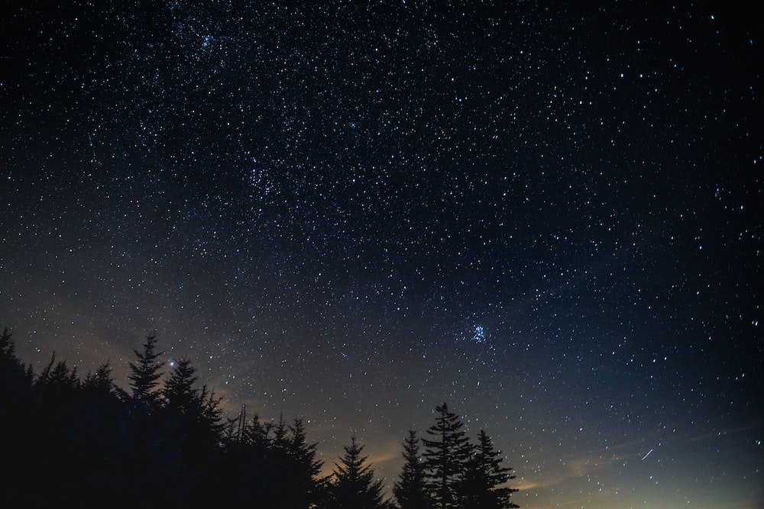
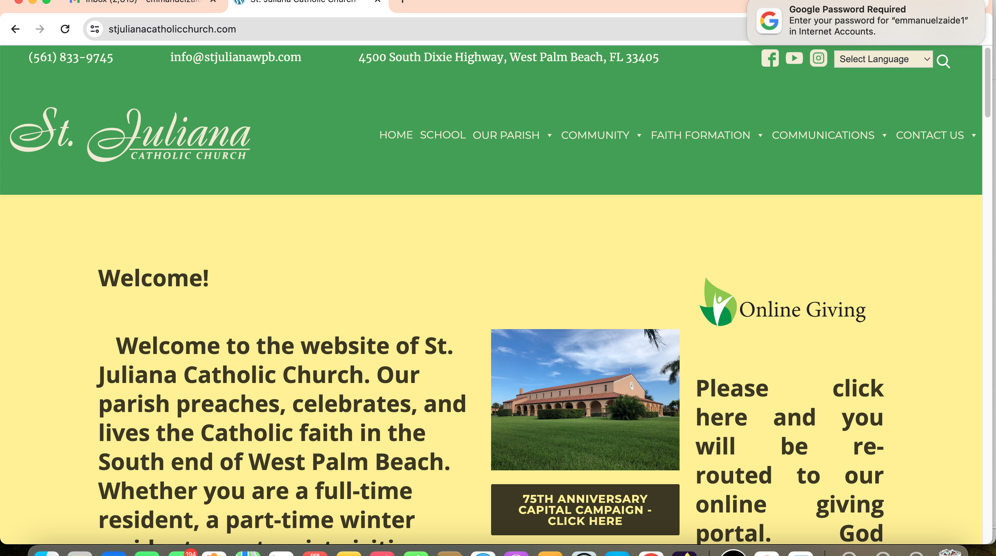
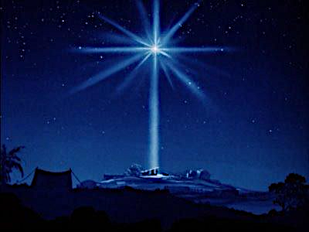
The Nativity of The Lord
Christmas
Night Holy Mass
Dec. 24, 2024

Slide 2
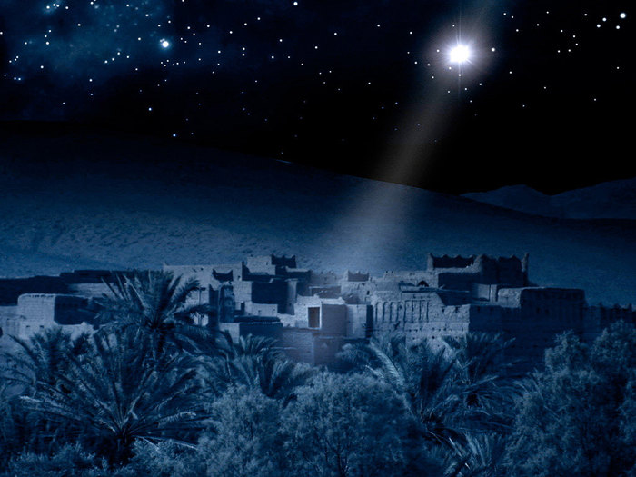

Slide 3
What Child Is This?
What Child is this, who laid to rest
on Mary’s lap is sleeping?
Whom angels greet with anthems sweet while shepherds watch are keping?

Slide 4
This, this is Christ the King,
whom shepherds guard and angels sing.
Haste, haste to bring Him laud,
the Babe, the Son of Mary.

Slide 5
Why lies He in such mean estate,
Where ox and ass are feeding?
Good Christians, fear,
for sinner here.
The silent word is pleading.

Slide 6
Nails, spear, shall pierce
Him through the cross be borne
For me, for you
Hail! Hail! TheWord made flesh
The Babe, the Son of Mary!

Slide 7
So bring Him incense, gold, and myrrh, come, peasant, king to own Him. The King of Kings, salvation brings, let loving hearts enthrone Him.

Slide 8
Raise, raise the song on high.
The virgin sings her lullaby.
Joy! Joy! For Christ is born,
The Babe, the Son of Mary!

Slide 10

O Holy Night
Arranged by Mark Hayes

Slide 11
O HOLY NIGHT!
THE STARS ARE
BRIGHTLY SHINING
IT IS THE NIGHT
OF OUR DEAR
SAVIOR’S BIRTH!

Slide 12
Father’s Solo:
LONG LAY THE WORLD IN SIN AND ERROR PINING
TILL HE APPEARED AND THE SOUL FELT IT WORTH

Slide 13
Father’s Solo:
A THRILL OF HOPE,
THE WEARY WORLD REJOICES
FOR YOUNDER BREAK A NEW AND GLORIOUS MORN!

Slide 14
Father’s Solo:
FALL ON YOUR KNEES!
O HEAR THE ANGEL VOICES!
O NIGHT DIVINE!
O NIGHT
WHEN CHRIST WAS BORN!
O NIGHT, DIVINE!
O NIGHT, O NIGHT DIVINE!

Slide 15
All:
TRULY HE TAUGHT US TO LOVE ONE ANOTHER
HIS LAW IS LOVE AND HIS GOSPEL IS PEACE;
CHAINS SHALL HE BREAK
FOR THE SLAVE IS OUR BRO—THER
AND IN HIS NAME ALL OPRES—SION SHALL CEASE

Slide 16
All:
CHAINS SHALL HE BREAK
FOR THE SLAVE IS OUR
BRO—THER
AND IN HIS NAME ALL
OPRES—SION SHALL CEASE

Slide 17
All:
SWEET HYMNS OF JOY IN GRATEFUL CHORUS RAISE WE, LET ALL WITH-IN US PRAISE HIS HOLY NAME

Slide 18
All:
CHRIST IS THE LORD, OH PRAISE HIS NAME FOR-E-VER!
HIS PO-WER AND GLO-RY,
EV-ER MORE PROCLAIM!
HIS POW’R - AND GLO---RY
EV—ER MORE PRO-CLAIM!

Slide 20

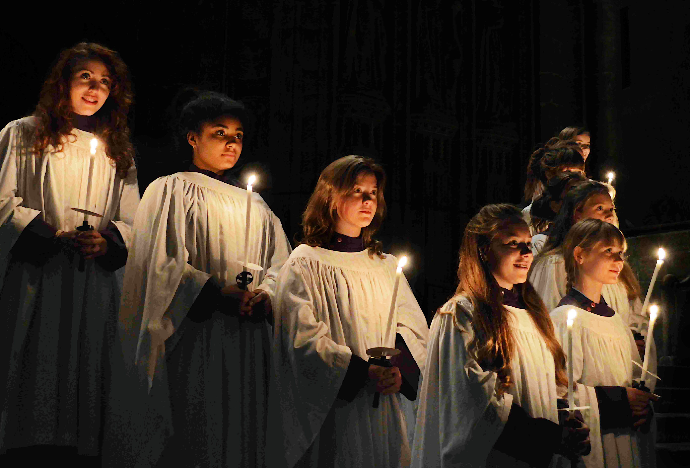
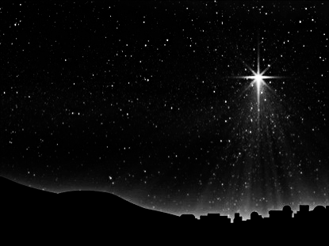

Entrance Hymn
O
O Come,
All Ye Faithful
Arr. By David Willocks

Slide 21
Entrance Hymn
O Come All Ye Faithful
Verse 1
O come, all ye faithful,
joyful and triumphant
O come ye, o come ye to Bethlehem
Come and behold Him,
born the King of Angels

Slide 22
Entrance Hymn
O Come All Ye Faithful
Refrain
O come, let us adore Him
O come, let us adore Him
O come, let us adore Him
Christ the Lord

Slide 23
Entrance Hymn
O Come All Ye Faithful
Verse 2
Venid, adoremos,
con alegre canto;
Venid al pueblito de Belèn.
Hoy ha nacido el
Rey de los ángeles.

Slide 24
Entrance Hymn
O Come All Ye Faithful
Refrain
Venid y adoremos,
Venid y adoremos,
Venid y adoremos a
Cristo Jesús.

Slide 25
Entrance Hymn
O Come All Ye Faithful
Verse 6
Sing, choirs of angels
Sing in exultation
Sing, all ye citizens of heav'n above!
Glory in the highest

Slide 26
Entrance Hymn
O Come All Ye Faithful
Refrain
O come, let us adore Him
O come, let us adore Him
O come, let us adore Him
Christ the Lord

Slide 27
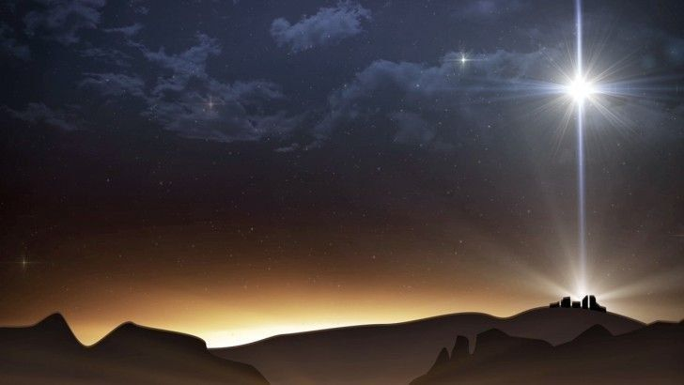
Verse 7
Yea, Lord, we greet thee,
Born this happy morning;
Jesus, to thee be glory giv’n!
Word of the Father,
Now in flesh appearing!

Slide 28
Refrain
O come, let us adore Him
O come, let us adore Him
O come, let us adore Him
Christ the Lord

Slide 29
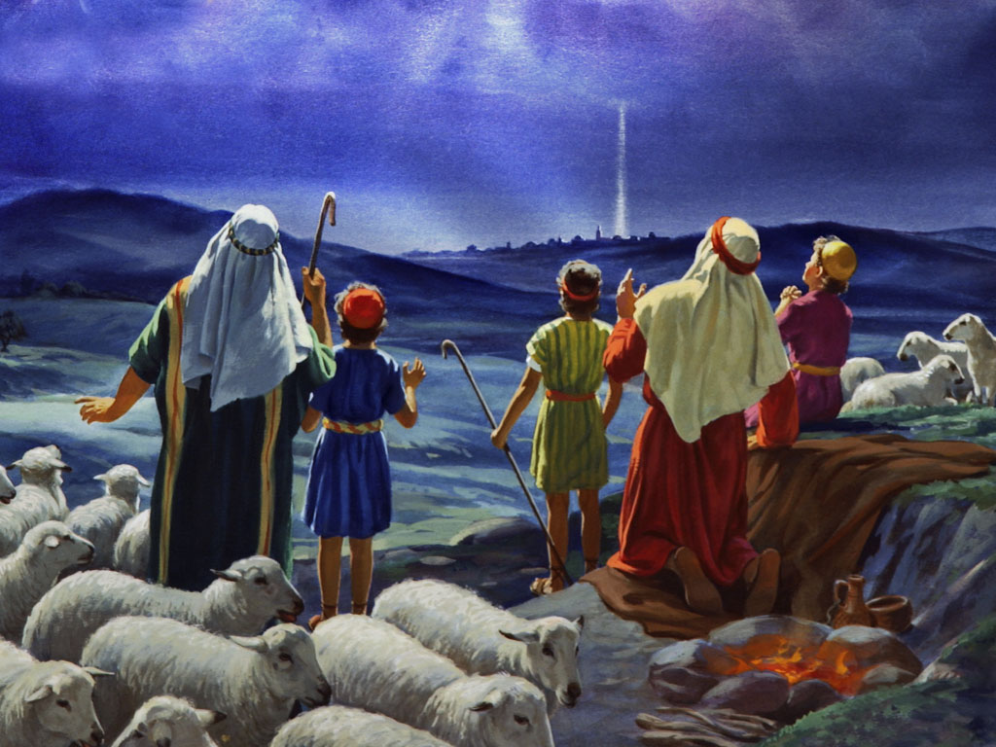

Slide 30
Glory! Glory to God in
the highest,
Glory! Glory to God in
the highest,
And on earth peace
to people of good will.
GLORY TO GOD

Slide 31
We praise You, we bless You,
we adore You, we glorify You,
we give You thanks
for Your great glory.
Lord God Heavenly King.
O God, Almighty Father.
Photo by Kumiko SHIMIZU on Unsplash
GLORY TO GOD

Slide 32
Lord Jesus Christ, Only Begotten Son
Lord God, Lamb of God,
Son of the Father,
You take away the sins of the world,
have mercy on us;
You take away the sins of the world.,
receive our prayer;
GLORY TO GOD

Slide 33
You are seated at
the right hand of the Father,
have mercy on us.
GLORY TO GOD

Slide 34
For you alone are the Holy One,
You alone are the Lord,
You alone are the Most High,
Jesus Christ,
with the Holy Spirit,
in the glory of God the Father
GLORY TO GOD

Slide 35
Glory! Glory to God in the highest,
Glory! Glory to God in the highest, and on earth
peace to people
of good will. Amen.
GLORY TO GOD

Slide 36
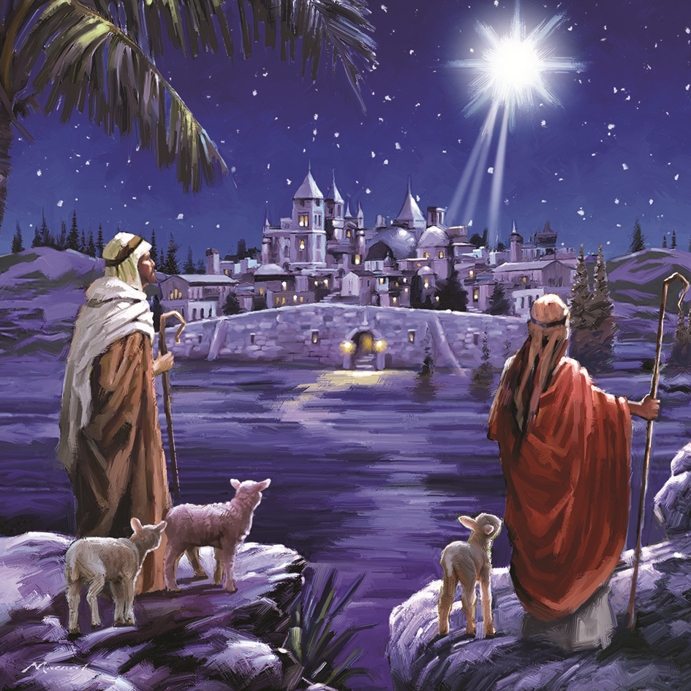

Slide 37
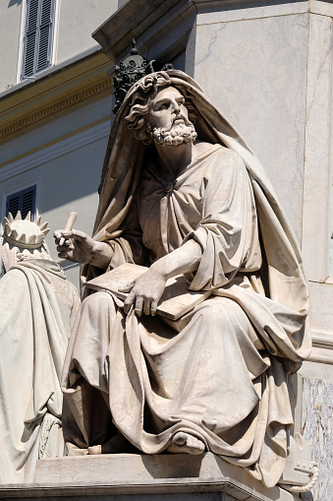
First Reading
Isaiah
9: 1-6

Slide 38
Entrance Hymn
O Come All Ye Faithful
First Reading
El pueblo que caminaba en tinieblas vio una gran luz;
Sobre los que vivían en tierra de sombras una luz resplandeció

Slide 39
Entrance Hymn
O Come All Ye Faithful
First Reading
Engrandeciste a tu pueblo e hiciste grande su alegría.
Se gozan en tu presencia como gozan al cosechar,
Como se alegran al repartirse el botín.

Slide 40
Entrance Hymn
O Come All Ye Faithful
First Reading
Porque tú quebrantaste su pesado yugo, la barra que oprimía sus hombros y el cetro de su tirano, como en el día Madián.

Slide 41
Entrance Hymn
O Come All Ye Faithful
First Reading
Porque un niño nos ha nacido, un hijo se nos ha dado;
Lleva sobre sus hombros el signo del imperio y su nombre será:
“ Consejero admirable,” “Dios poderoso,” “Padre sempiterno,” Principe de la paz”;

Slide 42
Entrance Hymn
O Come All Ye Faithful
First Reading
Para extender el principado con una paz sin limites
Sobre el trono de David y sobre su reino;

Slide 43
Entrance Hymn
O Come All Ye Faithful
First Reading
Para establecerlo y consolidarlo con la justicia y el derecho, desde ahora y para siempre.
El celo del Señor lo realizará.

Slide 44
Entrance Hymn
O Come All Ye Faithful
First Reading
The people who
walked in darkness
have seen a great light;
upon those who dwelt in the land of gloom
a light has shone.

Slide 45
Entrance Hymn
O Come All Ye Faithful
First Reading
You have brought
them abundant joy
and great rejoicing,
as they rejoice before you as
at the harvest,
as people make merry when dividing spoils.

Slide 46
Entrance Hymn
O Come All Ye Faithful
First Reading
For the yoke that
burdened them,
the pole on their shoulder,
and the rod of their taskmaster
you have smashed,
as on the day of Midian.

Slide 47
Entrance Hymn
O Come All Ye Faithful
First Reading
For every boot that
tramped in battle,
every cloak rolled in blood,
will be burned as fuel for flames.
For a Child is born to us,
a Son is given us;
upon His shoulder dominion rests.

Slide 48
Entrance Hymn
O Come All Ye Faithful
First Reading
They name Him
Wonder-Counselor,
God-Hero,
Father-Forever,
Prince of Peace.

Slide 49
Entrance Hymn
O Come All Ye Faithful
First Reading
His dominion is
Vast and forever
peaceful, from David’s throne,
and over His kingdom,
which He confirms
and sustains

Slide 50
Entrance Hymn
O Come All Ye Faithful
First Reading
by judgment and
justice, both now and forever.
The zeal of the LORD of hosts will do this!

Slide 51
The Word of The Lord
Thanks be to God

Slide 52
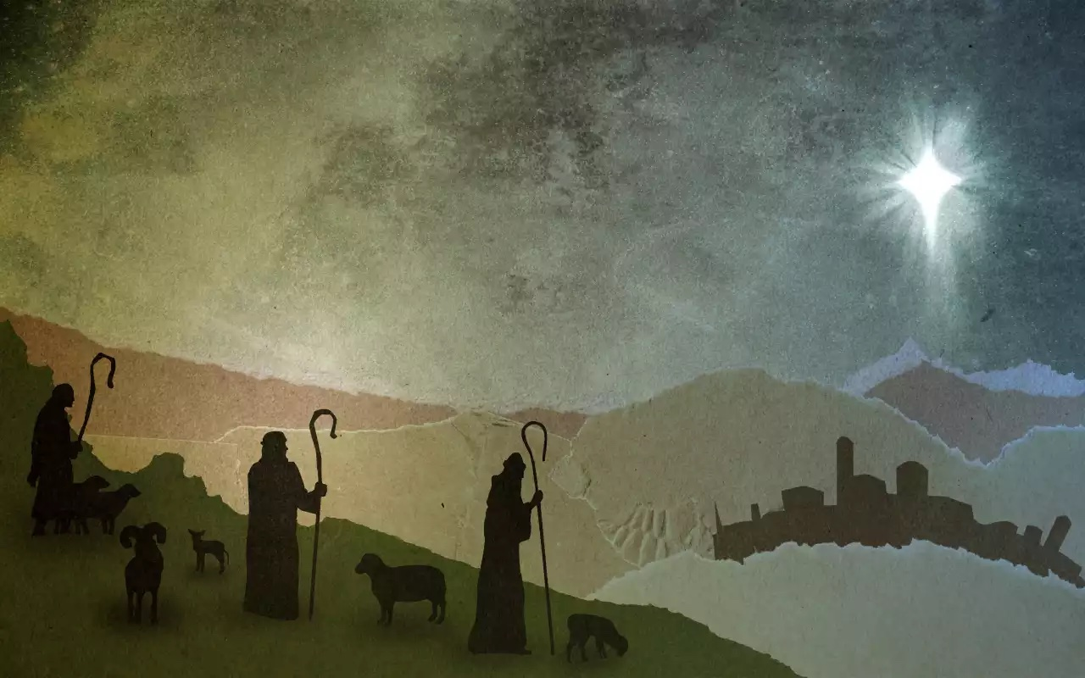

Slide 53
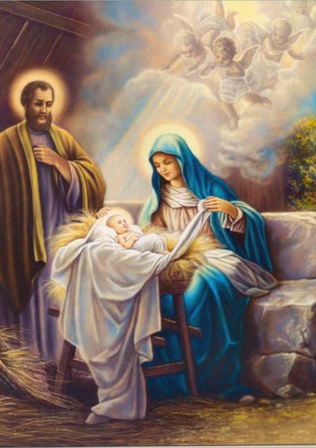
Responsorial Psalm
Ps 96: 1-2, 2-3, 11-12, 13.
Cantor:
Today is born our Savior, Jesus Christ the Lord.

Slide 54
Responsorial Psalm
Ps 96: 1-2, 2-3, 11-12, 13.
Response:
Today is born our Savior, Jesus Christ the Lord.

Slide 55
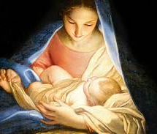
1. Sing to the LORD
a new song;
sing to the LORD,
all you lands.
Sing to the LORD:
bless His Name.

Slide 56
Responsorial Psalm
Ps 96: 1-2, 2-3, 11-12, 13.
Response:
Today is born our Savior, Jesus Christ the Lord.

Slide 57
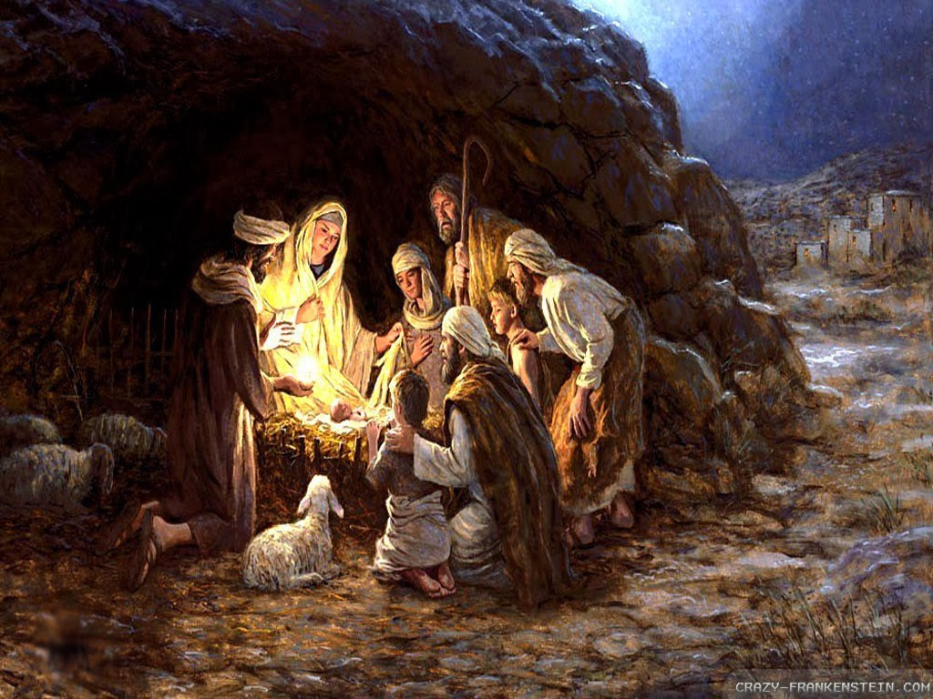
2. Announce His salvation, day
after day.
Tell His glory among the nations;
among all peoples, His wondrous deeds.
Responsorial Psalm

Slide 58
Responsorial Psalm
Ps 96: 1-2, 2-3, 11-12, 13.
Response:
Today is born our Savior, Jesus Christ the Lord.

Slide 59
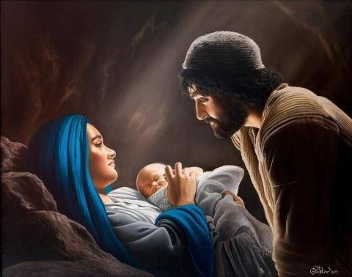
3. Let the heavens be glad and the earth rejoice; let the sea and what fills it resound;
let the plains be joyful and all that is
in them! Then shall all the trees of the forest exult.
Responsorial Psalm

Slide 60
Responsorial Psalm
Ps 96: 1-2, 2-3, 11-12, 13.
Response:
Today is born our Savior, Jesus Christ the Lord.

Slide 61
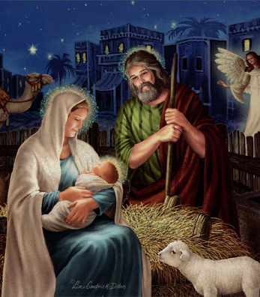
4. They shall exult before the LORD, for He comes;
for He comes to rule the earth.
He shall rule the world with justice
and the peoples with His constancy.

Slide 62
Responsorial Psalm
Ps 96: 1-2, 2-3, 11-12, 13.
Response:
Today is born our Savior, Jesus Christ the Lord.

Slide 63
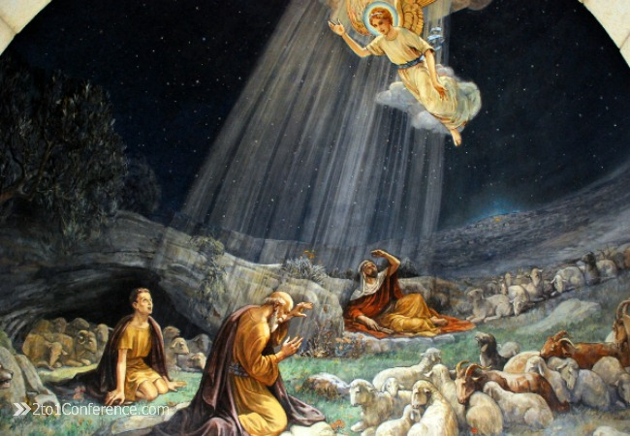

Slide 64
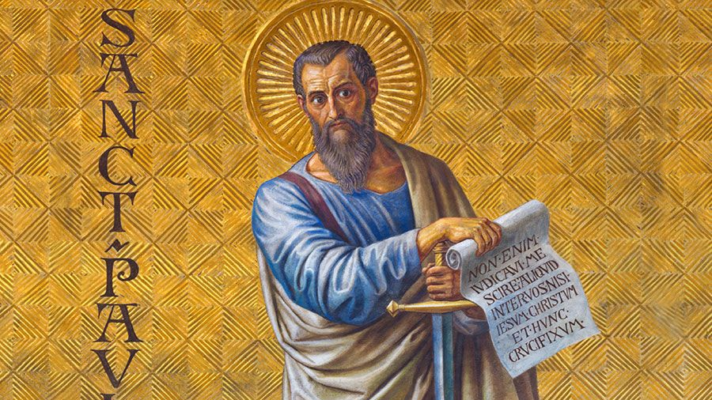
Second Reading: Titus 2: 11-14

Slide 65
Entrance Hymn
O Come All Ye Faithful
Second Reading
Beloved:
The grace of God has
appeared, saving all
and training us to reject godless
ways and worldly desires
and to live temperately, justly, and devoutly in this age,
as we await the blessed hope,

Slide 66
Entrance Hymn
O Come All Ye Faithful
Second Reading
the appearance of
the glory of our great
God and Savior Jesus
Christ, who gave Himself for us to deliver us from all lawlessness
and to cleanse for Himself
a people as his own,
eager to do what is good.

Slide 67
The Word of the Lord Thanks be to God

Slide 68
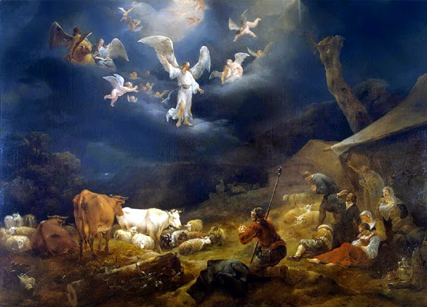

Slide 69
Alleluia, Alleluia, Alleluia.
Alleluia, Alleluia, Alleluia.
I proclaim to you
good news of great joy:
today a Savior is born for us,
Christ the Lord.
R. Alleluia, alleluia, Alleluia.
Alleluia

Slide 71
The Gospel
Luke 2: 1-14

Slide 72
Entrance Hymn
O Come All Ye Faithful
Gospel Reading
Por aquellos dias, se promulgó un edicto de César Augusto, que ordenaba un censo de todo el imperio. Este primer censo se hizo cuando Quirino era gobernador de Siria.

Slide 73
Entrance Hymn
O Come All Ye Faithful
Gospel Reading
Todos iban a empadronarse, cada uno en su propia ciudad; así es que también José, perteneciente a la casa y familia de David, se dirigió dese la cuidad de Nazaret, en Galilea, a la ciudad de David, llamada Belén, para empadronarse, juntamente con maria, su esposa, que estaba encinta.

Slide 74
Entrance Hymn
O Come All Ye Faithful
Gospel Reading
Mientras estaban ahí, le llegó a María el tiempo de dar a luz y tuvo a su hijo primogénito: lo envolvió en pañales y lo recostó en un pesebre, porque no hubo lugar para ellos en la posada.

Slide 75
Entrance Hymn
O Come All Ye Faithful
Gospel Reading
En aquaria región habiá unos pastores que pasaban la noche en el campo, vigilando por turno sus rebaños. Un ángel del Señor se les apareció y la gloria de Dios los envolvió con su luz y se llenaron de temor.

Slide 76
Entrance Hymn
O Come All Ye Faithful
Gospel Reading
El ángel les dijo:
“ No teman. Les traigo una buena notica, que causará gran alegría a todo el pueblo: hoy les ha nacido, en la ciudad de David, un Salvador, que es el Mesias, el Señor. Esto les servirá de señal: encontrarán al niño envuelto en pañales y recostado en un pesebre.”

Slide 77
Entrance Hymn
O Come All Ye Faithful
De pronto se le unió al ángel una multitud del ejército celestial, que alababa a Dios, diciendo: “Gloria a Dios en el cielo, y en la tierra paz a los hombres de buena voluntad!”
Gospel Reading

Slide 78
Entrance Hymn
O Come All Ye Faithful
Gospel Reading
In those days a decree
went out from Caesar
Augustusthat the whole
world should be enrolled.
This was the first enrollment,
when Quirinius was governor
of Syria.

Slide 79
Entrance Hymn
O Come All Ye Faithful
Gospel Reading
So all went to be enrolled,
each to his own town.
And Joseph too went up from Galilee from the town of Nazareth
to Judea, to the city of David that is called Bethlehem,

Slide 80
Entrance Hymn
O Come All Ye Faithful
Gospel Reading
because He was of the
house and family of David,
to be enrolled with Mary, His betrothed, who was with child.

Slide 81
Entrance Hymn
O Come All Ye Faithful
Gospel Reading
While they were there,
the time came for her
to have her child,
and she gave birth to
her firstborn son.

Slide 82
Entrance Hymn
O Come All Ye Faithful
Gospel Reading
She wrapped Him in swaddling clothes and laid Him in a manger,
because there was no room for
them in the Inn.

Slide 83
Entrance Hymn
O Come All Ye Faithful
Gospel Reading
Now there were
shepherds in that region
living in the fields
and keeping the night watch
over their flock.

Slide 84
Entrance Hymn
O Come All Ye Faithful
Gospel Reading
The angel of the Lord
appeared to them
and the glory of the Lord shone around them, and they
were struck with great fear.

Slide 85
Entrance Hymn
O Come All Ye Faithful
Gospel Reading
The angel said to them,
“Do not be afraid;
for behold, I proclaim to you
good news of great joy
that will be for all the people.

Slide 86
Entrance Hymn
O Come All Ye Faithful
Gospel Reading
For today in the city
of David a Savior has
been born for you who
is Christ and Lord.
And this will be a sign for you:

Slide 87
Entrance Hymn
O Come All Ye Faithful
Gospel Reading
you will find an
infant wrapped in
swaddling clothes
and lying in a manger.”
And suddenly there was a multitude of the heavenly host with the angel,
praising God and saying:

Slide 88
Entrance Hymn
O Come All Ye Faithful
Gospel Reading
“Glory to God in the highest
and on earth peace to those
on whom His favor rests.”

Slide 89
The Gospel of the Lord
Praise to You, Lord Jesus christ

Slide 91
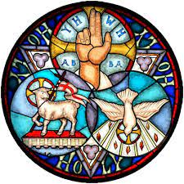
Nicene Creed
I believe in one God, the Father almighty, maker of heaven and earth, of all things visible and invisible.

Slide 92
Nicene Creed
I believe in one Lord Jesus Christ, the Only Begotten
Son of God, born of the Father before
all ages.

Slide 93
Nicene Creed
God from God, Light from Light, true God from true God, begotten, not made, consubstantial with the Father; through Him all things
were made.

Slide 94
Nicene Creed
For us men and for our salvation He came down from heaven,
PLEASE BOW
and by the Holy Spirit was incarnate of the Virgin Mary, and became man.

Slide 95
Nicene Creed
For our sake He was
crucified under Pontius Pilate, He suffered death and was buried, and rose again on the third day in accordance with the Scriptures.

Slide 96
Nicene Creed
He ascended into heaven and is seated at the right hand of the Father. He will come again in glory to judge the living and the dead and His kingdom will have no end.

Slide 97
Nicene Creed
I believe in the Holy Spirit, the Lord, the giver of life, who proceeds from the Father and the Son, who with the Father and the Son is adored and glorified,
who has spoken through
the prophets.

Slide 98
Nicene Creed
I believe in one, holy catholic and apostolic Church. I confess one Baptism for the forgiveness of sins and I look forward to the resurrection of the dead and the life of the world to come. Amen

Slide 99
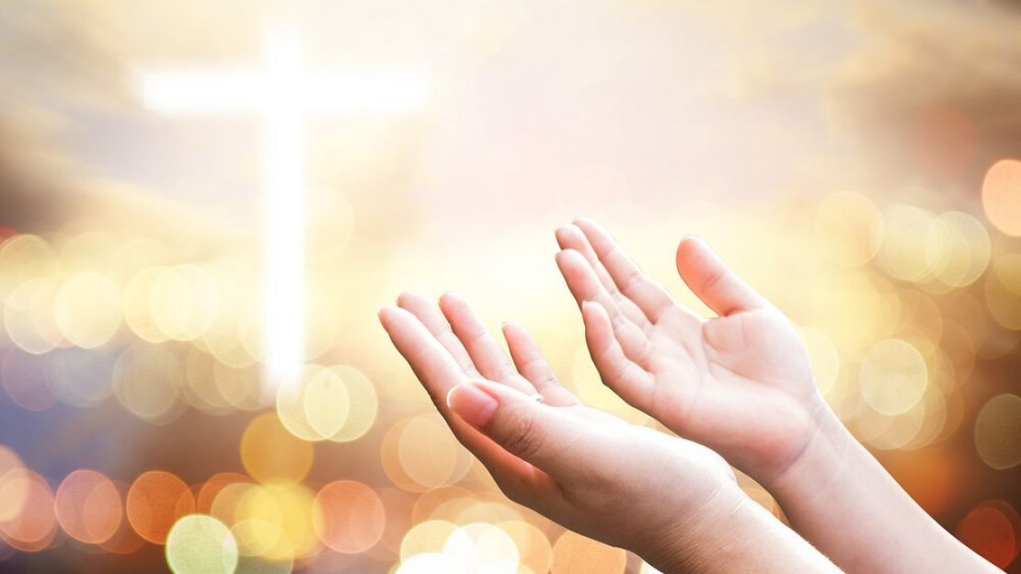
Prayers of the Faithful
Lord, Hear our prayer.

Slide 100
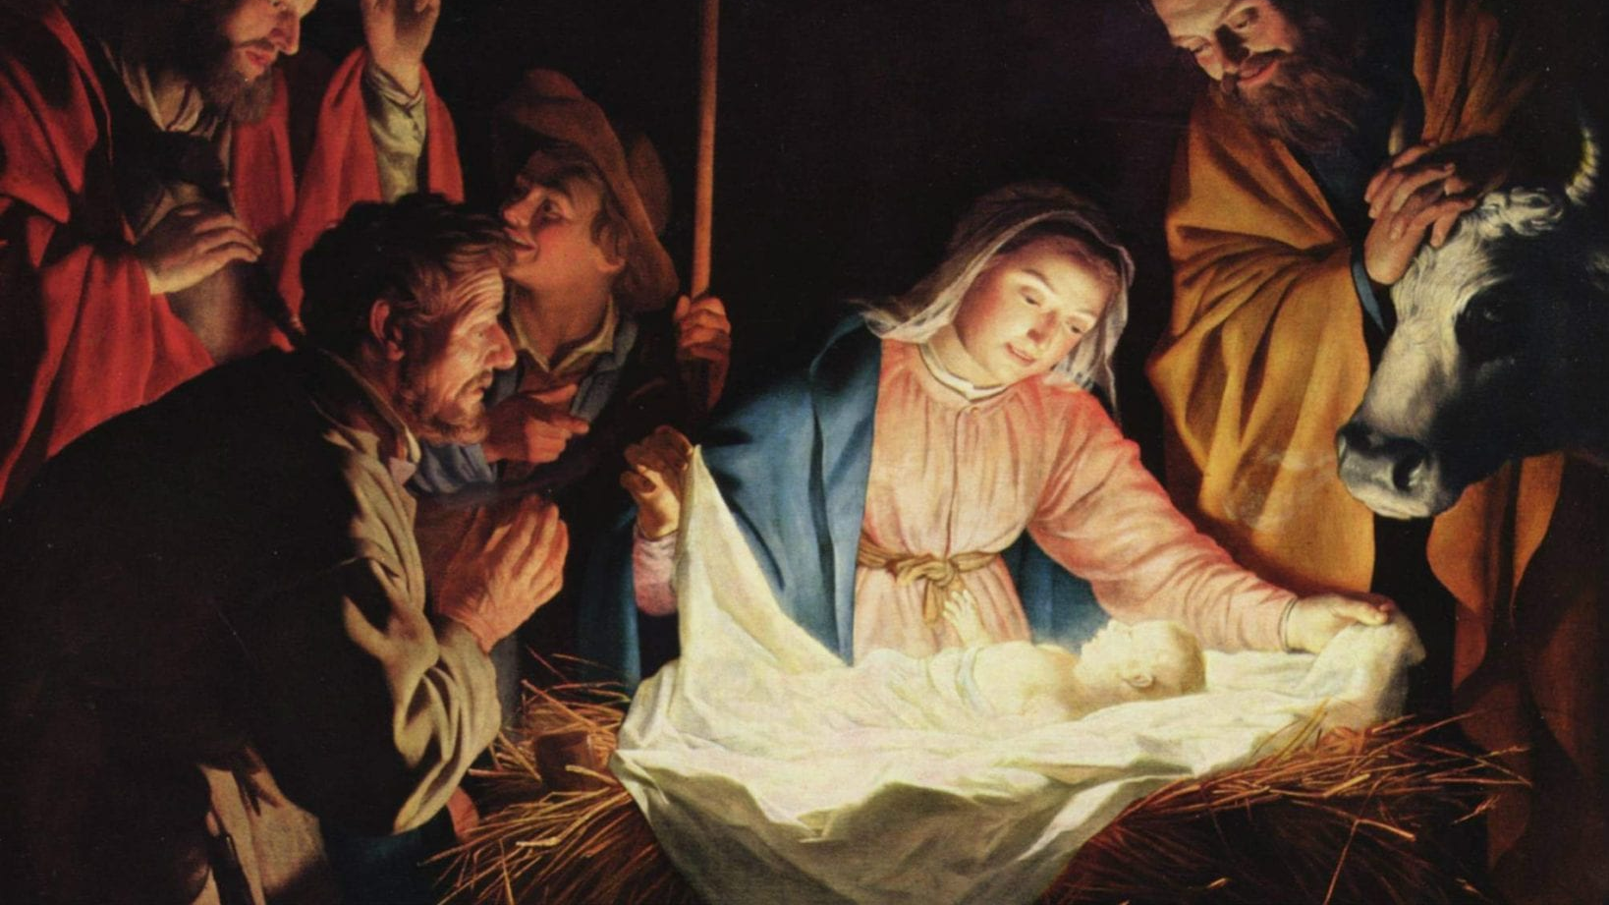

Slide 101
Offertory Hymn
O
Away in the Manger
By William J. Kirkpatrick
Arr. By Ola Gjielo

Slide 102
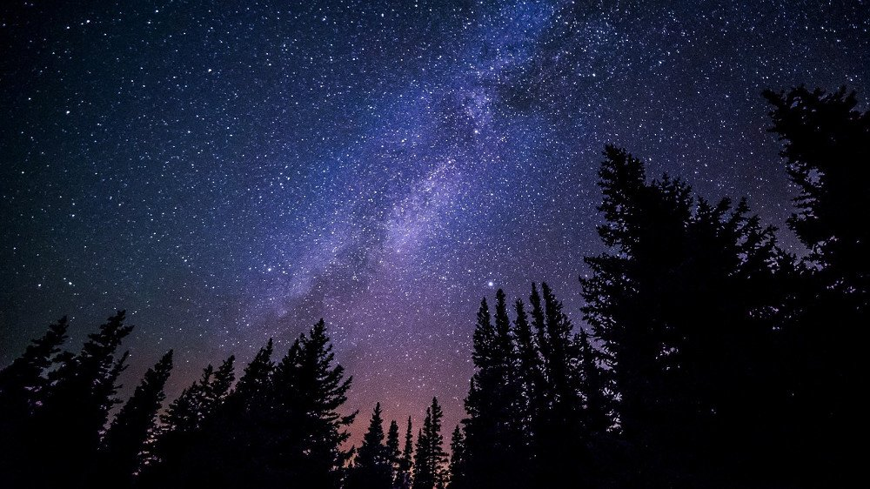
Verse 1
Away in a manger,
no crib for a bed,
the little Lord Jesus
laid down His sweet head;
The stars in the bright sky
looked down where He lay,
The little Lord Jesus asleep on the hay.

Slide 103
Verse 2
The cattle are lowing,
The Baby wakes,
but little Lord Jesus,
no crying He makes.
I love Thee, Lord Jesus,
look down from the sky
and stay by my side until morning is nigh.

Slide 104
Verse 3
Be near me, Lord Jesus;
I ask Thee to stay
close by me forever,
And love me, I pray.
Bless all the dear children
in Thy tender care, and take us to heaven, to live with Thee there.

Slide 105
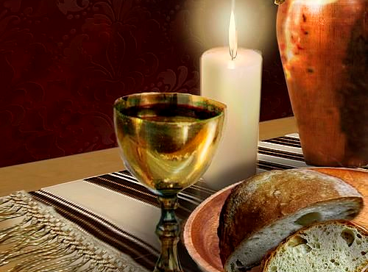

Slide 106
Priest:
Pray, brethren, that my sacrifice
and yours may be acceptable to God,
the almighty Father.
All: May the Lord accept the sacrifice at Your hands for the praise and glory of His name, for our good and the good of all His Holy Church

Slide 108
  Preface Acclamation
Holy, Holy, Holy Lord
God of hosts.
Heaven and earth,
are full of Your glory,
Hosanna in the highest

Slide 109
Blessed is He,
who comes,
in the name of
the Lord.
Hosanna in the highest
Hosanna in the highest
  Preface Acclamation

Slide 110
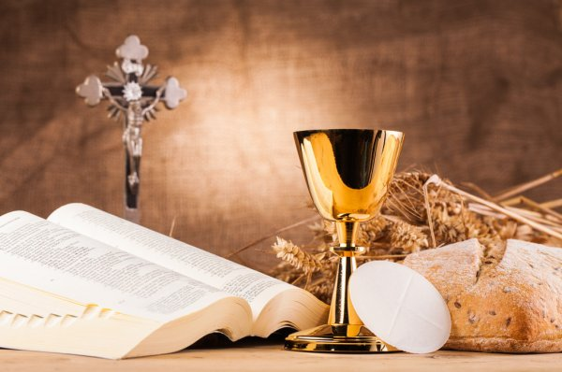

Slide 111
Memorial Acclamation
When we eat this Bread and drink this Cup, we proclaim Your death, O Lord
Until You come again.

Slide 113
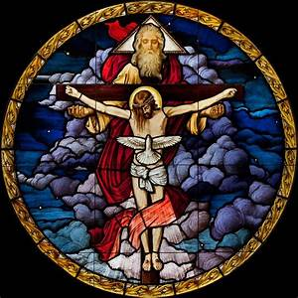
Concluding
Doxology
Amen,
Amen, Amen,
Amen, Amen!
Amen,
Amen, Amen,
Amen, Amen!
Amen,
Amen,
Amen!

Slide 114
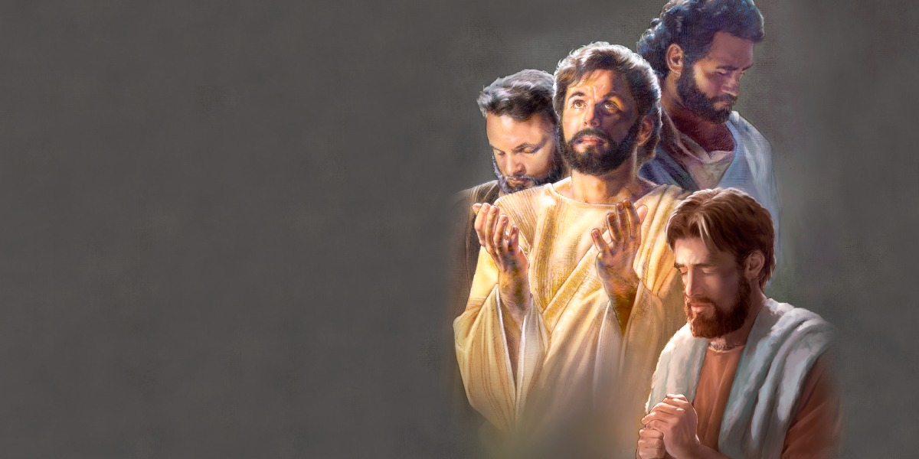
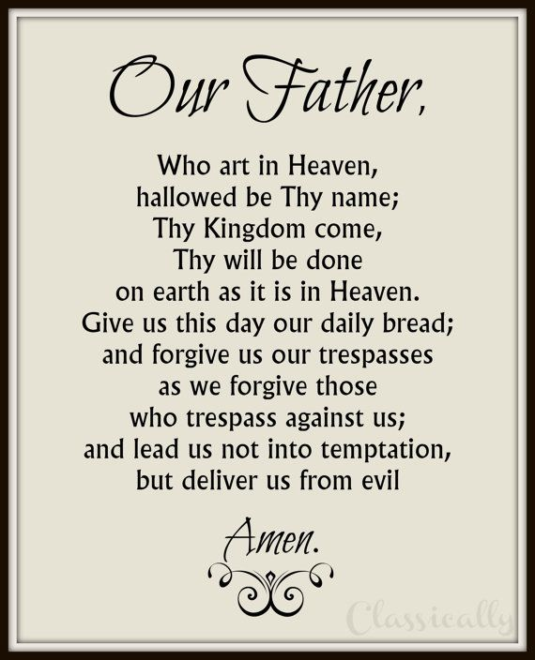
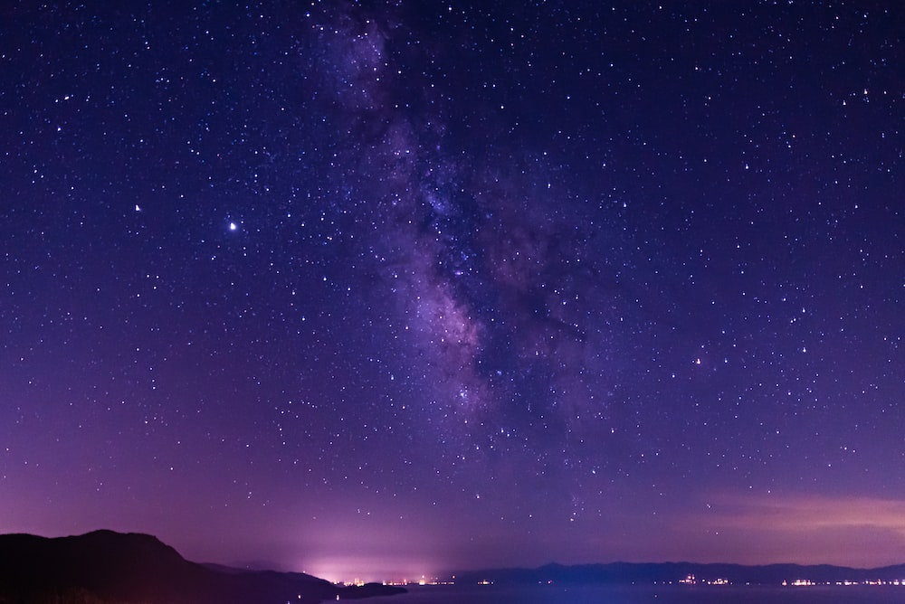
For the kingdom, the power and the glory
are Yours now and forever.
For the kingdom, the power and the glory
are Yours now and forever.

Slide 115


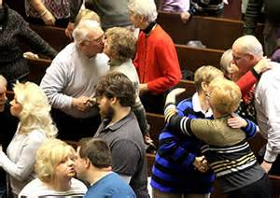
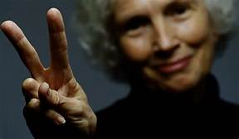
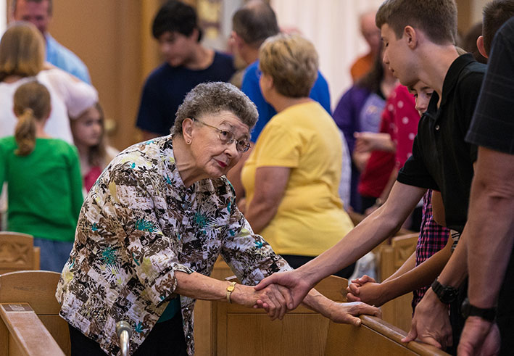
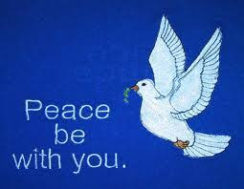
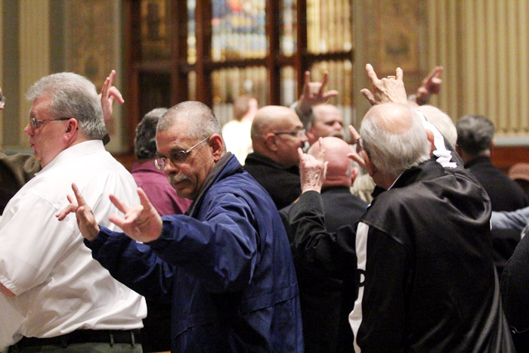
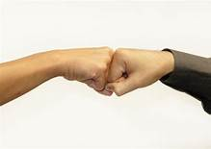
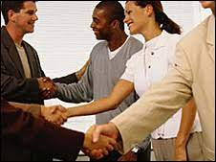
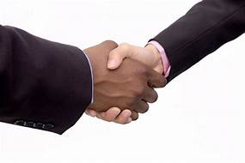

Slide 116
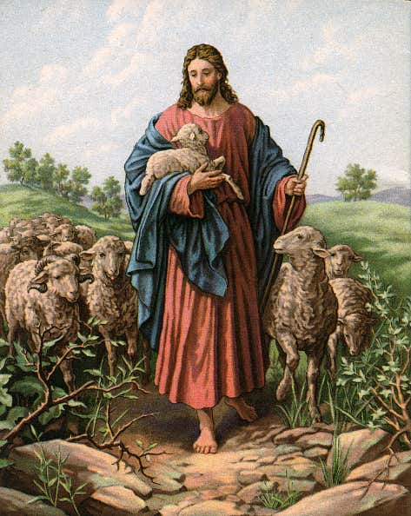
Lamb of God
Lamb of God
You take way the
si-ns of the world,
have mercy,
have mercy on us.

Slide 117
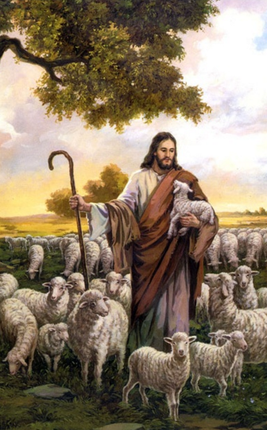
Lamb of God
Lamb of God
You take way the
si-ns of the world,
have mercy,
have mercy on us.

Slide 118
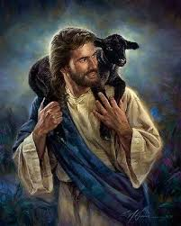
Lamb of God
Lamb of God
You take way the
si-ns of the world,
grant us,
gra-nt u-s peace.

Slide 119
Priest:
Behold the Lamb of God, behold Him who takes away the sins of the world. Blessed are those called to the supper of the Lamb..
All:
Lord I am not worthy that You should enter under my roof, but only say the word and my soul shall be healed.

Slide 121
Communion Hymn 1
The First Noel
By W. Sandy
Arr. By Dan Forrest

Slide 122
Verse 1
The first Noel the angel did say
Was to certain poor shepherds
in fields as they lay,
In fields where they lay
keeping their sheep
On a cold winter’s night
that was so deep.

Slide 123
Refrain
Noel, Noel, Noel, Noel!
Born is the King of Israel!

Slide 124
Verse 2
They looked up
and saw a star
Shining in the East beyond them far, And to the earth it gave great light,
And so it continued
both day and night.

Slide 125
Refrain
Noel, Noel, Noel, Noel!
Born is the King of Israel!

Slide 126
Verse 6
Then let us all
With one accord
Sing praises to our Heavenly Lord;
Who with the Father we adore,
And Spirit blest
For ever more.

Slide 128
Communion Hymn 2
He Shall Reign
By Heather Sorenson

Slide 129
Verse 1
In the bleak mid-winter,
all creation groans
For a world in darkness,
frozen like a stone
Light is breaking
In a stable for a throne

Slide 130
And He shall reign
forevermore, forevermore
And He shall reign
forevermore, forevermore
Unto us a child is born
The King of kings and Lord of lords
And He shall reign forevermore, forevermore
Refrain

Slide 131
Verse 2
If I were a wise man,
I would travel far
And if I were a shepherd,
I would do my part
But poor as I am
I will give to Him my heart

Slide 132
And He shall reign forevermore, forevermore
And He shall reign forevermore, forevermore
Unto us a child is born
The King of kings and Lord of lords
And He shall reign forevermore, forevermore
Refrain

Slide 133
Verse 3
Here within a manger lies
The One who made the starry skies
This baby born for sacrifice
Christ, the Messiah
Into our hopes, into our fears
The Savior of the world appears
The promise of eternal years
Christ, the Messiah

Slide 134
He shall reign. (Gloria)
forevermore, forevermore
And He shall reign (Gloria)
forevermore, forevermore
He shall reign
forevermore, forevermore
He shall reign (Gloria)
forevermore, forevermore
Refrain

Slide 135
Unto us a child is born
The King of kings and Lord of lords
And He shall reign forevermore, forevermore
Refrain

Slide 136
In Excelcis Deo!
He shall reign,
He shall reign,
He shall reign!
(Repeat as needed)
Outro

Slide 138
Communion Hymn 3
Silent Night
Arr. By Dan Forrest

Slide 139
Verse 1
Silent night, holy night
All is calm, all is bright
Round yon Virgin Mother and Child
Holy Infant so tender and mild
Sleep in heavenly peace
Sleep in heavenly peace

Slide 140
Verse 2
Silent night, holy night
Son of God, love's pure light
Radiant beams from Thy holy face
With the dawn of redeeming grace
Jesus Lord, at Thy birth!
Jesus Lord, at Thy birth!

Slide 141
Instrumental Bridge

Slide 142
Verse 3
Silent night, holy night
Wondrous Star lend Thy night
With the angels let us sing
“Alleluia” to our King
Christ the Savior is born!
Christ the Savior is born!

Slide 143
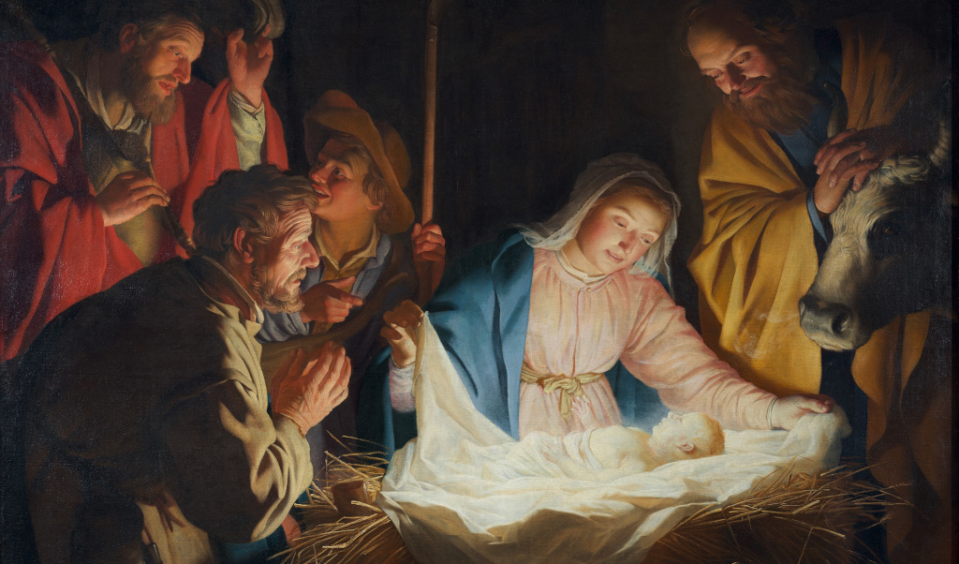

Slide 144

Recessional Hymn
Joy to the World
George F Hanel
1658-1759

Slide 145
Verse 1
Joy to the world, the Lord is come!
Let earth receive her King!
Let every heart prepare Him room,
and heav'n and nature sing,
and heav'n and nature sing,
and heav'n, and heav'n and nature sing.

Slide 146
Verse 2
Joy to the earth, the Savior reigns!
Let men their songs employ,
while fields and floods,
rocks, hills, and plains
repeat the sounding joy,
repeat the sounding joy,
repeat, repeat the sounding joy.

Slide 147
Verse 3
No more let sin and sorrow grow,
No thorns infest the ground.
He comes to make His blessings flow
Far as the curse is found
Far as the curse is found
Far as, Far is the curse is found

Slide 148
Verse 3
He rules the world
with truth and grace,
and makes the nations prove
the glories of His righteousness
and wonders of His love,
and wonders of His love,
and wonders, wonders of His love.

Slide 149

MERRY CHRISTMAS
TO YOU AND
YOUR FAMILY!
FROM SAINT JULIANA FAMILY

