Slide 1

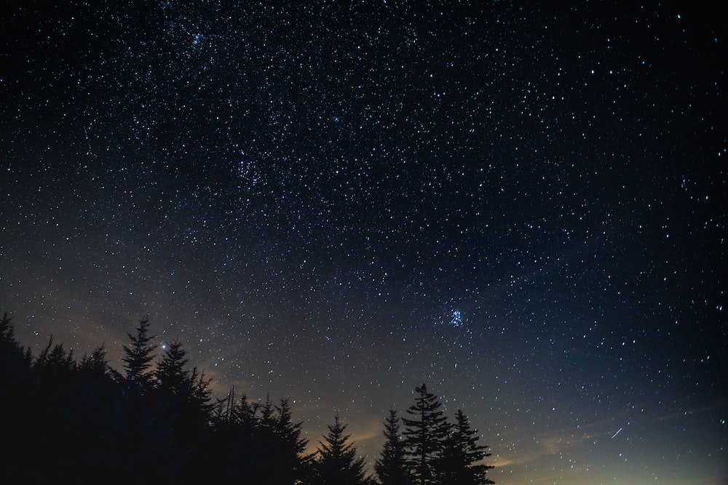
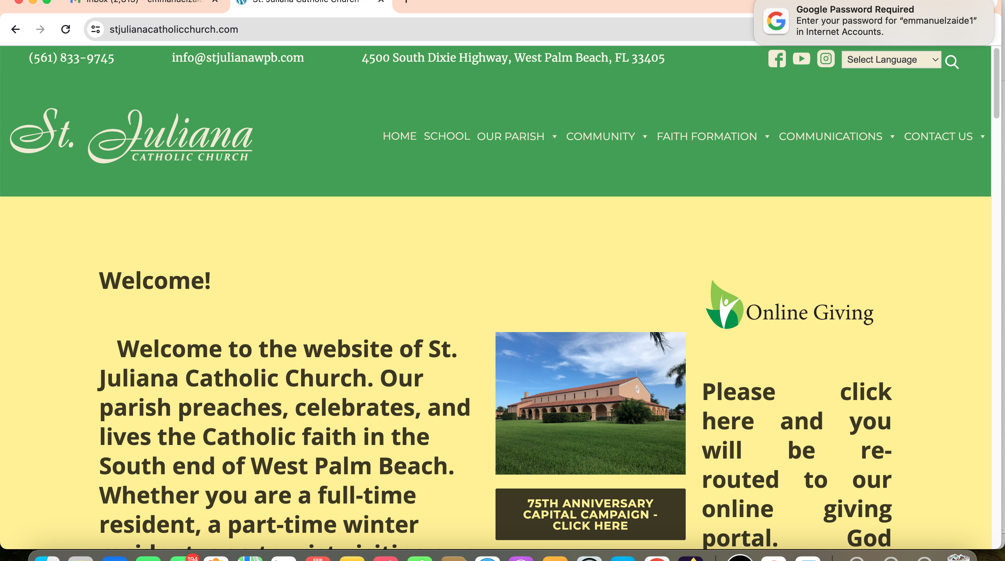
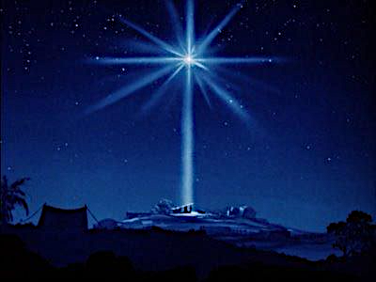
The Nativity of The Lord
Christmas
Day Holy Mass
Dec. 25, 2024

Slide 2
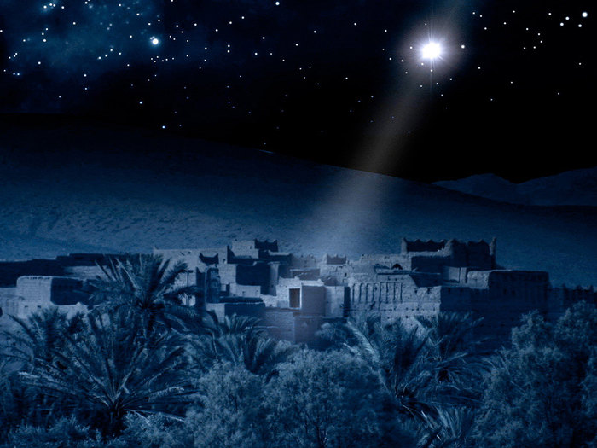

Slide 3

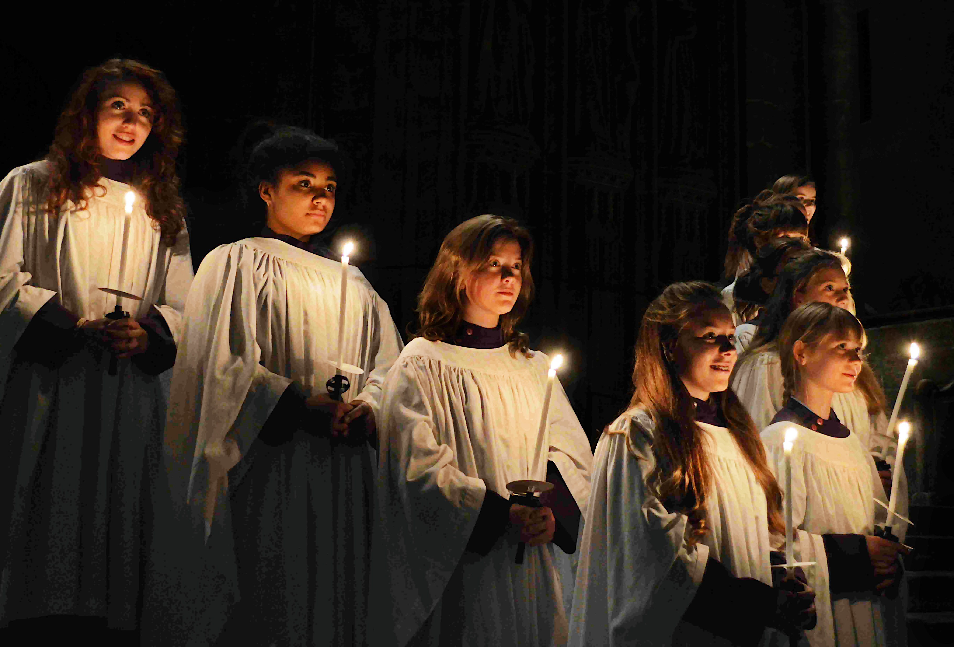
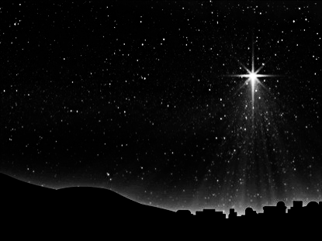

Entrance Hymn
O
O Come,
All Ye Faithful
Arr. By David Willocks

Slide 4
Entrance Hymn
O Come All Ye Faithful
Verse 1
O come, all ye faithful,
joyful and triumphant
O come ye, o come ye to Bethlehem
Come and behold Him,
born the King of Angels

Slide 5
Entrance Hymn
O Come All Ye Faithful
Refrain
O come, let us adore Him
O come, let us adore Him
O come, let us adore Him
Christ the Lord

Slide 6
Entrance Hymn
O Come All Ye Faithful
Verse 2
True God from true God,
Light from Light eternal,
behold, He comes forth from
the Virgin’s womb,
Son of God, begotten, not created

Slide 7
Entrance Hymn
O Come All Ye Faithful
Refrain
O come, let us adore Him
O come, let us adore Him
O come, let us adore Him
Christ the Lord

Slide 8
Entrance Hymn
O Come All Ye Faithful
Verse 6
Sing, choirs of angels
Sing in exultation
Sing, all ye citizens of heav'n above!
Glory in the highest

Slide 9
Entrance Hymn
O Come All Ye Faithful
Refrain
O come, let us adore Him
O come, let us adore Him
O come, let us adore Him
Christ the Lord

Slide 10
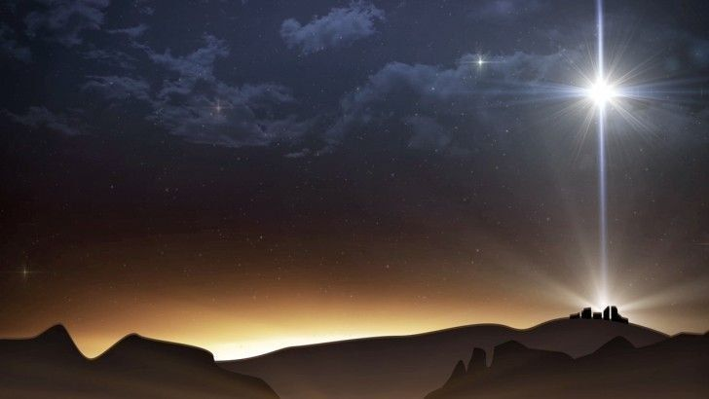
Verse 7
Yea, Lord, we greet thee,
Born this happy morning;
Jesus, to thee be glory giv’n!
Word of the Father,
Now in flesh appearing!

Slide 11
Refrain
O come, let us adore Him
O come, let us adore Him
O come, let us adore Him
Christ the Lord

Slide 12
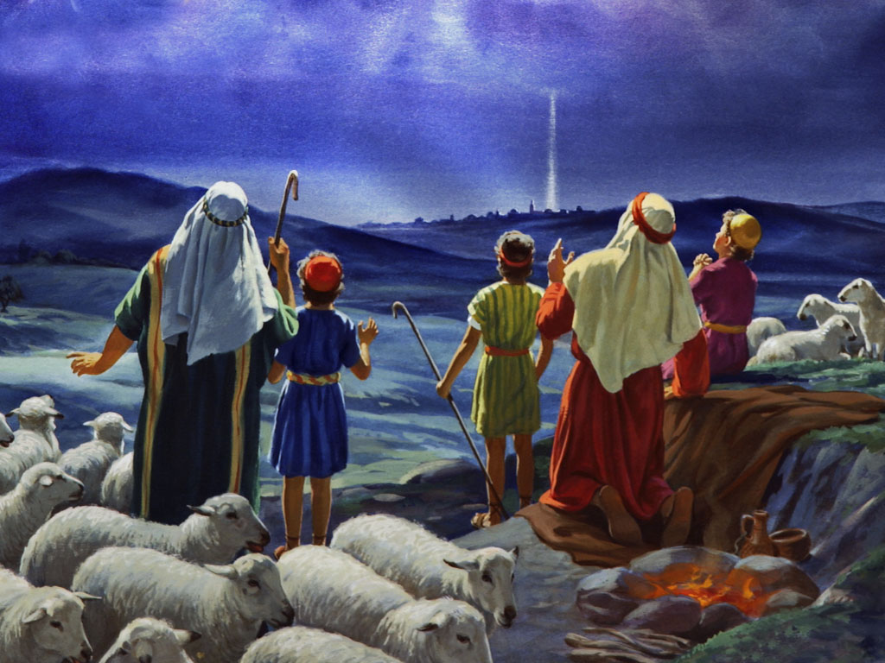

Slide 13
Glory! Glory to God in
the highest,
Glory! Glory to God in
the highest,
And on earth peace
to people of good will.
GLORY TO GOD

Slide 14
We praise You, we bless You,
we adore You, we glorify You,
we give You thanks
for Your great glory.
Lord God Heavenly King.
O God, Almighty Father.
Photo by Kumiko SHIMIZU on Unsplash
GLORY TO GOD

Slide 15
Lord Jesus Christ, Only Begotten Son
Lord God, Lamb of God,
Son of the Father,
You take away the sins of the world,
have mercy on us;
You take away the sins of the world.,
receive our prayer;
GLORY TO GOD

Slide 16
You are seated at
the right hand of the Father,
have mercy on us.
GLORY TO GOD

Slide 17
For you alone are the Holy One,
You alone are the Lord,
You alone are the Most High,
Jesus Christ,
with the Holy Spirit,
in the glory of God the Father
GLORY TO GOD

Slide 18
Glory! Glory to God in the highest,
Glory! Glory to God in the highest, and on earth
peace to people
of good will. Amen.
GLORY TO GOD

Slide 19
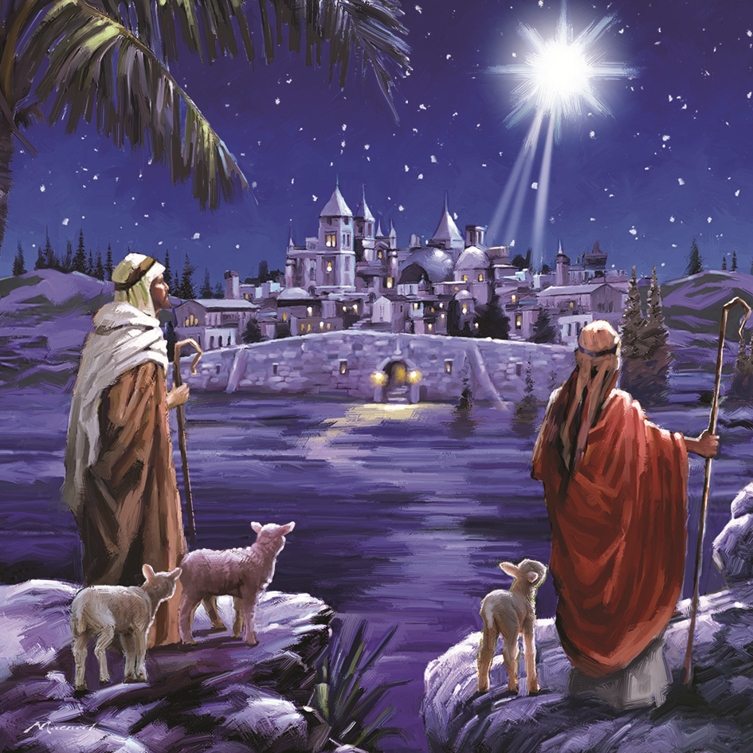

Slide 20
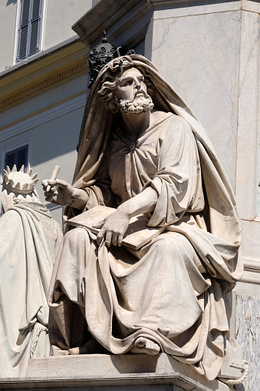
First Reading
Isaiah
52: 7-10

Slide 21
Entrance Hymn
O Come All Ye Faithful
First Reading
How beautiful upon
the mountains
are the feet of Him who brings glad tidings, announcing peace, bearing good news, announcing salvation, and saying to Zion,
“Your God is King!”

Slide 22
Entrance Hymn
O Come All Ye Faithful
First Reading
Hark! Your sentinels
raise a cry, together they
shout for joy, for they see
directly, before their eyes,
the LORD restoring Zion.
Break out together in song,
O ruins of Jerusalem!

Slide 23
Entrance Hymn
O Come All Ye Faithful
First Reading
For the LORD comforts
His people,
He redeems Jerusalem.
The LORD has bared His holy arm
in the sight of all the nations;
all the ends of the earth will behold
the salvation of our God..

Slide 24
The Word of The Lord
Thanks be to God

Slide 25
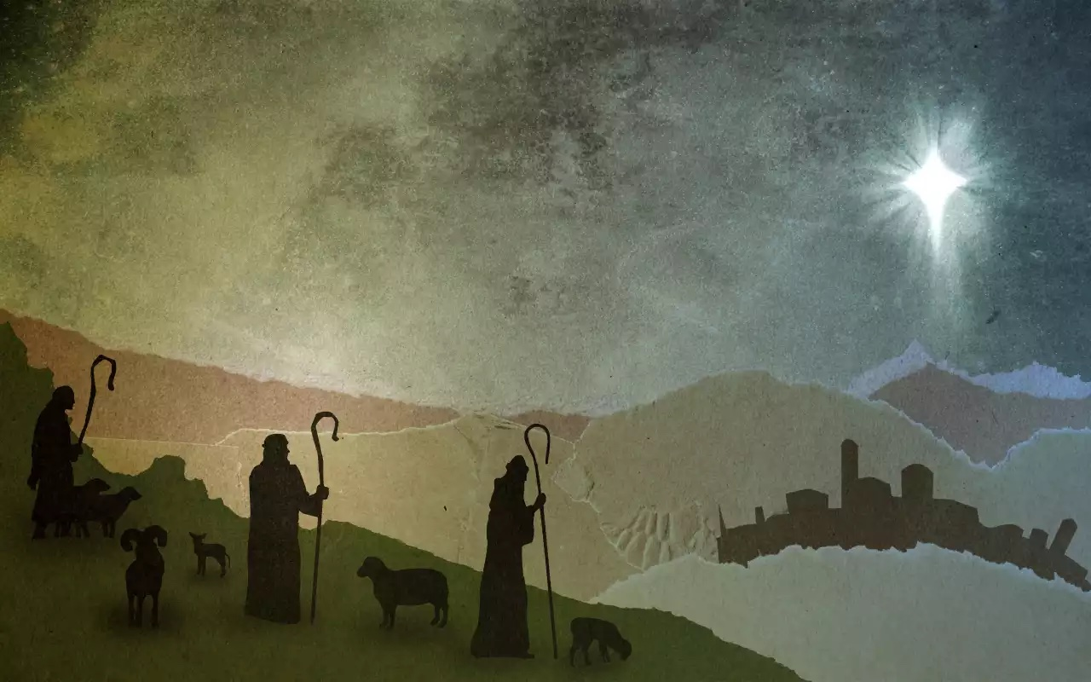

Slide 26
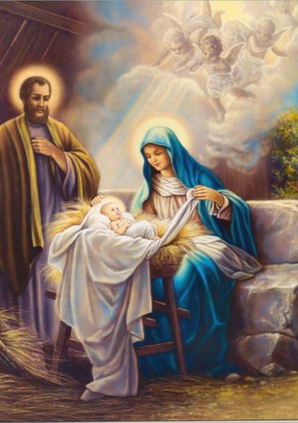
Responsorial Psalm
Ps 98:1, 2-3, 3-4, 5-6.
Cantor:
All the ends of the earth have seen the saving power
of God.

Slide 27
Responsorial Psalm
Ps 98:1, 2-3, 3-4, 5-6.
Response:
All the ends of the earth have seen the saving power
of God.

Slide 28
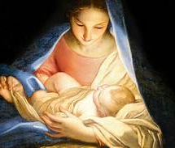
1. Sing to the LORD a new song,
for He has done wondrous deeds;
His right hand has won victory for Him,
His holy arm.

Slide 29
Responsorial Psalm
Ps 98:1, 2-3, 3-4, 5-6.
Response:
All the ends of the earth have seen the saving power
of God.

Slide 30
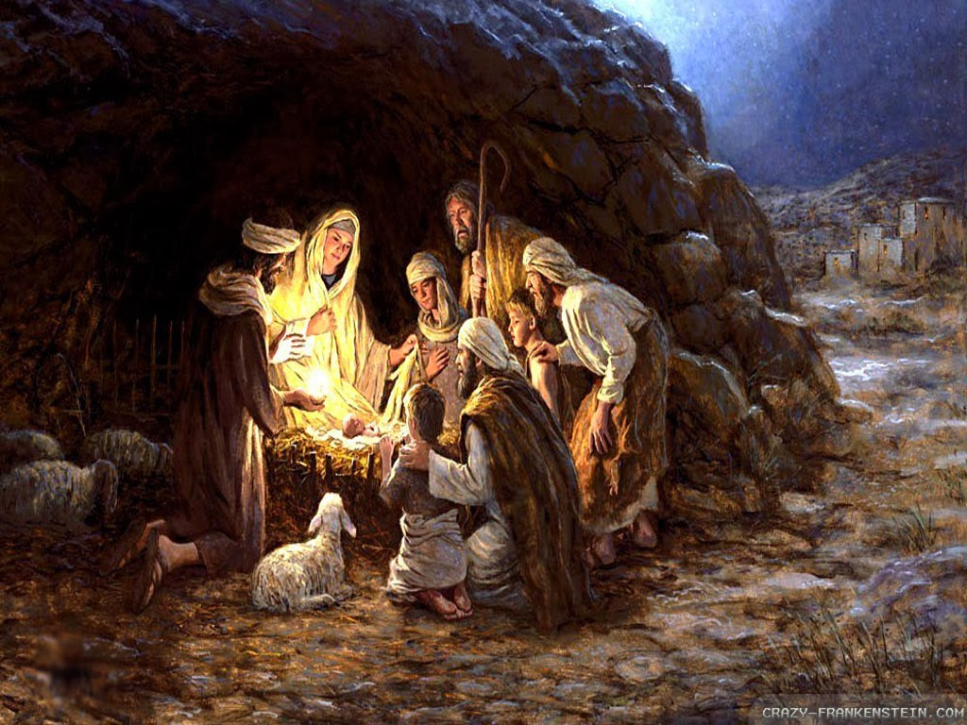
2. The LORD has made His salvation known:
in the sight of the nations He has revealed His justice.
He has remembered
His kindness and His faithfulness
toward the house
of Israel.
Responsorial Psalm

Slide 31
Responsorial Psalm
Ps 98:1, 2-3, 3-4, 5-6.
Response:
All the ends of the earth have seen the saving power
of God.

Slide 32
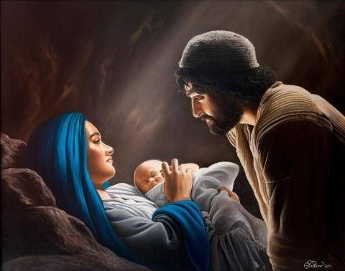
3. All the ends of the earth have seen
the salvation by our God.
Sing joyfully to the LORD, all you lands; break into song; sing praise.
Responsorial Psalm

Slide 33
Responsorial Psalm
Ps 98:1, 2-3, 3-4, 5-6.
Response:
All the ends of the earth have seen the saving power
of God.

Slide 34
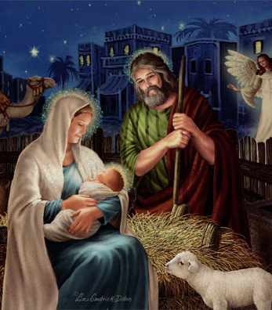
4. Sing praise to the LORD with the harp,
with the harp and melodious song.
With trumpets and the sound of the horn
sing joyfully before the King, the LORD.

Slide 35
Responsorial Psalm
Ps 98:1, 2-3, 3-4, 5-6.
Response:
All the ends of the earth have seen the saving power
of God.

Slide 36
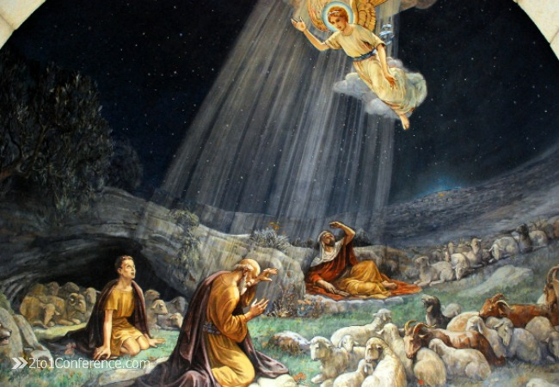

Slide 37
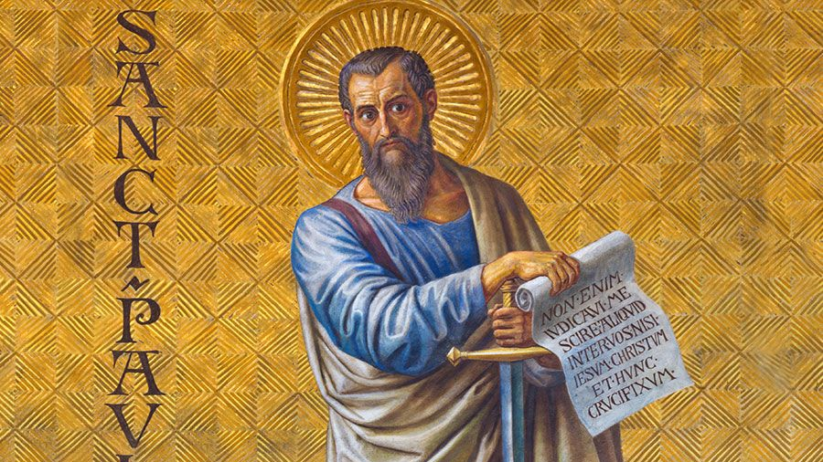
Second Reading: Hebrews 1: 1-6

Slide 38
Entrance Hymn
O Come All Ye Faithful
Second Reading
Brothers and sisters:
In times past, God spoke
in partial and various ways
to our ancestors through the prophets;
in these last days, He has spoken to us through the Son,
whom he made heir of all things
and through whom
He created the universe,

Slide 39
Entrance Hymn
O Come All Ye Faithful
Second Reading
who is the refulgence
of His glory
the very imprint of his being,
and who sustains all things by His mighty word.

Slide 40
Entrance Hymn
O Come All Ye Faithful
Second Reading
When he had
accomplished purification
from sins, He took His seat
at the right hand of the Majesty
on high as far superior to the angels
as the name He has inherited is more excellent than theirs.

Slide 41
Entrance Hymn
O Come All Ye Faithful
Second Reading
For to which of the angels
did God ever say:
You are my son; this day
I have begotten you?

Slide 42
Entrance Hymn
O Come All Ye Faithful
Second Reading
I will be a Father to Him,
and He shall be a Son to me?
And again, when He leads the firstborn into the world, he says:
Let all the angels of God worship Him.

Slide 43
The Word of the Lord Thanks be to God

Slide 44
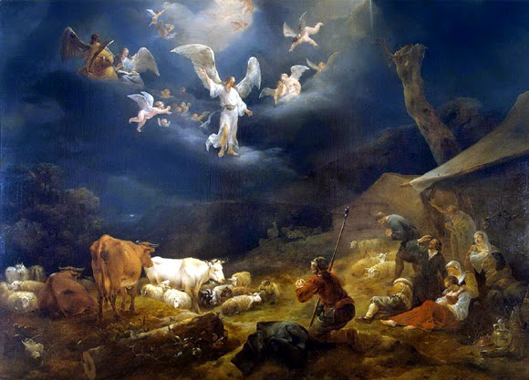

Slide 45
Alleluia, Alleluia, Alleluia.
Alleluia, Alleluia, Alleluia.
A holy day has dawned upon us.
Come, you nations, and adore the Lord.
For today a great light has come
upon the earth.
R. Alleluia, alleluia, Alleluia.
Alleluia

Slide 47
The Gospel
John 1: 1-18

Slide 48
Entrance Hymn
O Come All Ye Faithful
Gospel Reading
In the beginning was the Word, and the Word
was with God,
and the Word was God.
He was in the beginning with God.

Slide 49
Entrance Hymn
O Come All Ye Faithful
Gospel Reading
All things came
to be through Him,
and without Him
nothing came to be.
What came to be
through Him was life,
and this life was the light
of the human race;

Slide 50
Entrance Hymn
O Come All Ye Faithful
Gospel Reading
the light shines
in the darkness,
and the darkness
has not overcome it.
A man named John
was sent from God.

Slide 51
Entrance Hymn
O Come All Ye Faithful
Gospel Reading
He came for testimony,
to testify to the light,
so that all might believe
through Him.
He was not the light,
but came to testify to the light.

Slide 52
Entrance Hymn
O Come All Ye Faithful
The true light,
which enlightens everyone,
was coming into the world.
He was in the world,
and the world came to
be through Him
but the world did not
know Him.
Gospel Reading

Slide 53
Entrance Hymn
O Come All Ye Faithful
Gospel Reading
He came to what
was his own,
but His own people
did not accept Him.

Slide 54
Entrance Hymn
O Come All Ye Faithful
Gospel Reading
But to those who
did accept Him
He gave power to become
children of God,

Slide 55
Entrance Hymn
O Come All Ye Faithful
to those who believe
in His name,
who were born not by natural generation nor by human choice nor by a man’s decision
but of God.
Gospel Reading

Slide 56
Entrance Hymn
O Come All Ye Faithful
Gospel Reading
And the Word
became flesh
and made His dwelling among us, and we saw His glory,
the glory as of the Father’s only Son, full of grace and truth

Slide 57
Entrance Hymn
O Come All Ye Faithful
Gospel Reading
John testified to Him
and cried out, saying,
“This was he of whom I said,
‘The one who is coming after
me ranks ahead of me
because He existed before me.’”

Slide 58
Entrance Hymn
O Come All Ye Faithful
Gospel Reading
From His fullness
we have all received,
grace in place of grace,
because while the law was
given through Moses,
grace and truth came
through Jesus Christ.

Slide 59
Entrance Hymn
O Come All Ye Faithful
Gospel Reading
No one has ever seen God.
The only Son, God,
who is at the Father’s side,
has revealed Him.

Slide 60
The Gospel of the Lord
Praise to You, Lord Jesus Christ

Slide 62
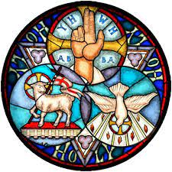
Nicene Creed
I believe in one God, the Father almighty, maker of heaven and earth, of all things visible and invisible.

Slide 63
Nicene Creed
I believe in one Lord Jesus Christ, the Only Begotten
Son of God, born of the Father before
all ages.

Slide 64
Nicene Creed
God from God, Light from Light, true God from true God, begotten, not made, consubstantial with the Father; through Him all things
were made.

Slide 65
Nicene Creed
For us men and for our salvation He came down from heaven,
PLEASE BOW
and by the Holy Spirit was incarnate of the Virgin Mary, and became man.

Slide 66
Nicene Creed
For our sake He was
crucified under Pontius Pilate, He suffered death and was buried, and rose again on the third day in accordance with the Scriptures.

Slide 67
Nicene Creed
He ascended into heaven and is seated at the right hand of the Father. He will come again in glory to judge the living and the dead and His kingdom will have no end.

Slide 68
Nicene Creed
I believe in the Holy Spirit, the Lord, the giver of life, who proceeds from the Father and the Son, who with the Father and the Son is adored and glorified,
who has spoken through
the prophets.

Slide 69
Nicene Creed
I believe in one, holy catholic and apostolic Church. I confess one Baptism for the forgiveness of sins and I look forward to the resurrection of the dead and the life of the world to come. Amen

Slide 70
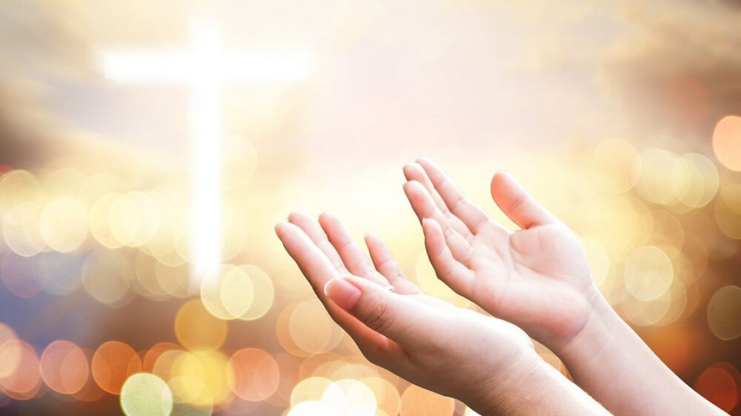
Prayers of the Faithful
Lord, Hear our prayer.

Slide 71
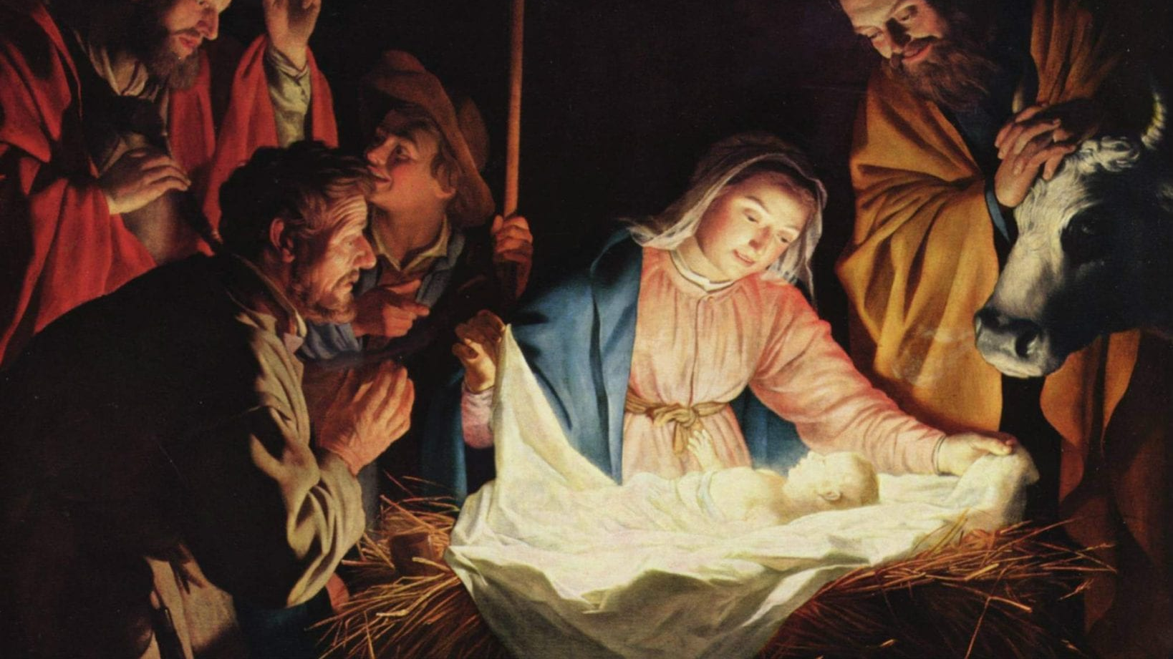

Slide 72
Offertory Hymn
O
Away in the Manger
By William J. Kirkpatrick
Arr. By Ola Gjielo

Slide 73
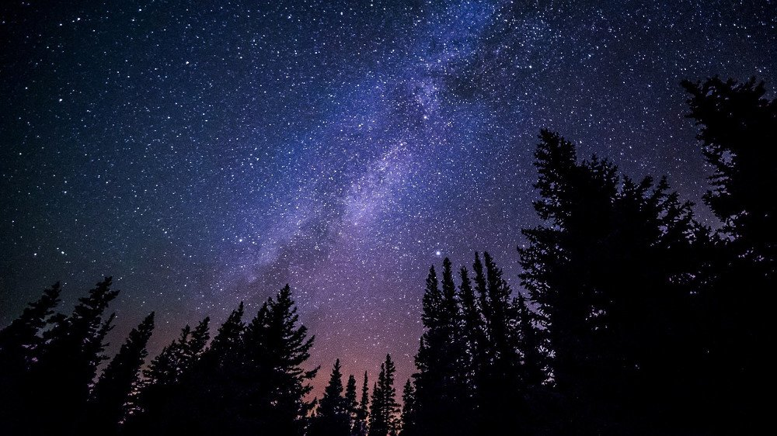
Verse 1
Away in a manger,
no crib for a bed,
the little Lord Jesus
laid down His sweet head;
The stars in the bright sky
looked down where He lay,
The little Lord Jesus asleep on the hay.

Slide 74
Verse 2
The cattle are lowing,
The Baby wakes,
but little Lord Jesus,
no crying He makes.
I love Thee, Lord Jesus,
look down from the sky
and stay by my side until morning is nigh.

Slide 75
Verse 3
Be near me, Lord Jesus;
I ask Thee to stay
close by me forever,
And love me, I pray.
Bless all the dear children
in Thy tender care, and take us to heaven, to live with Thee there.

Slide 76
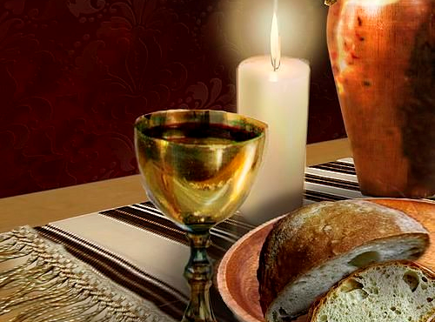

Slide 77
Priest:
Pray, brethren, that my sacrifice
and yours may be acceptable to God,
the almighty Father.
All: May the Lord accept the sacrifice at Your hands for the praise and glory of His name, for our good and the good of all His Holy Church

Slide 79
  Preface Acclamation
Holy, Holy, Holy Lord
God of hosts.
Heaven and earth,
are full of Your glory,
Hosanna in the highest

Slide 80
Blessed is He,
who comes,
in the name of
the Lord.
Hosanna in the highest
Hosanna in the highest
  Preface Acclamation

Slide 81
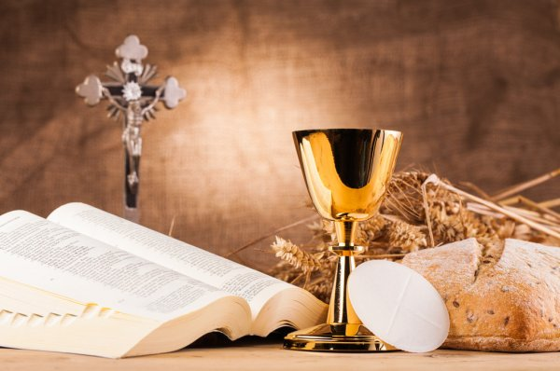

Slide 82
Memorial Acclamation
When we eat this Bread and drink this Cup, we proclaim Your death, O Lord
Until You come again.

Slide 84
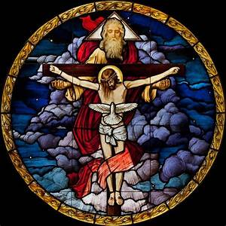
Concluding
Doxology
Amen,
Amen, Amen,
Amen, Amen!
Amen,
Amen, Amen,
Amen, Amen!
Amen,
Amen,
Amen!

Slide 85
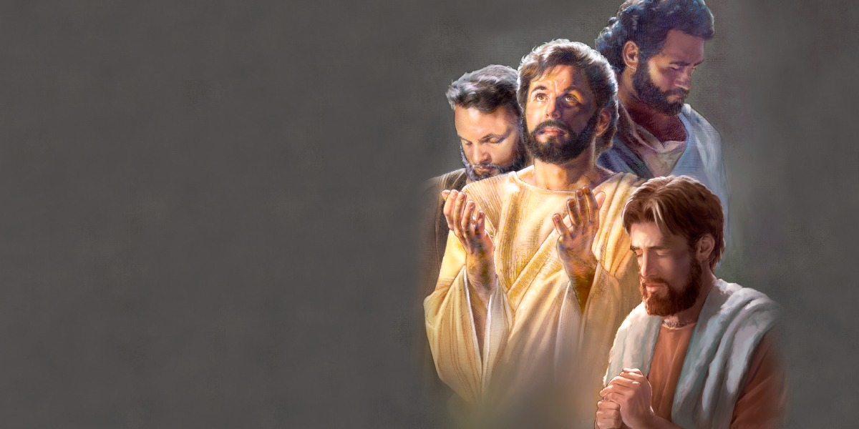
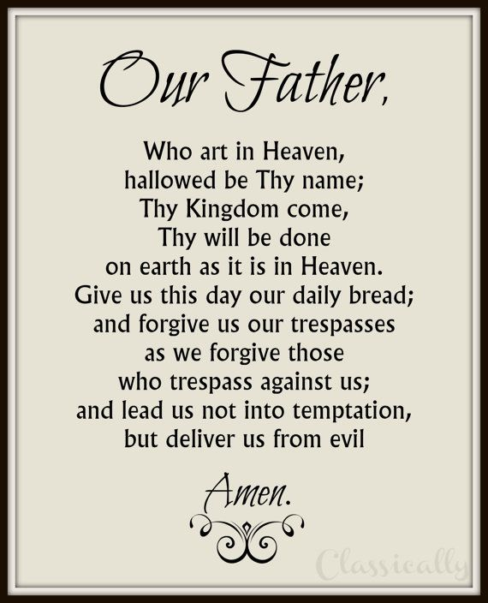
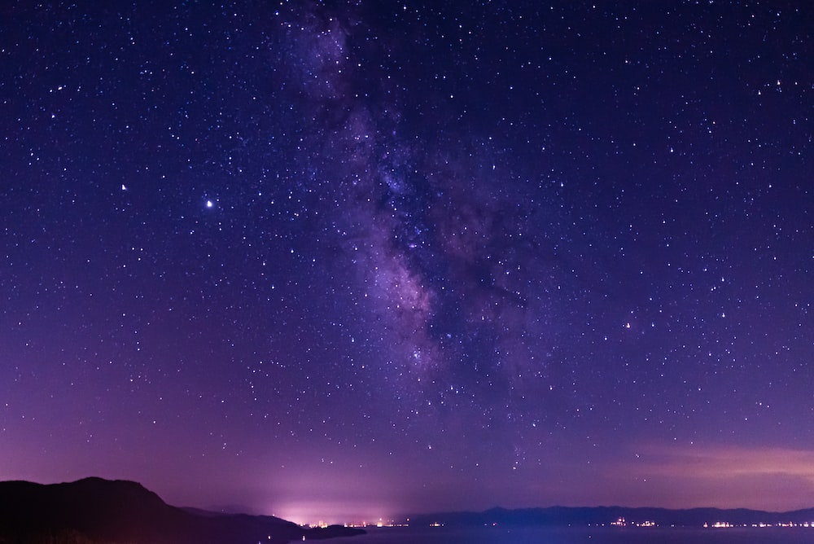
For the kingdom, the power and the glory
are Yours now and forever.
For the kingdom, the power and the glory
are Yours now and forever.

Slide 86


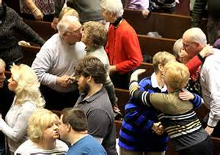
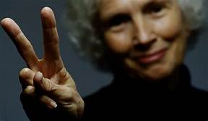
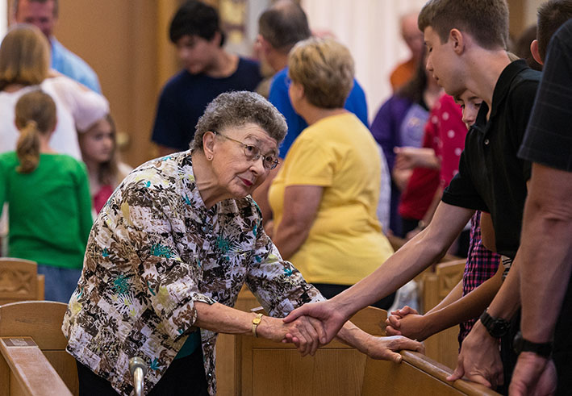
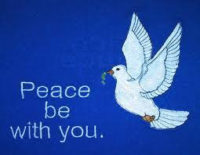
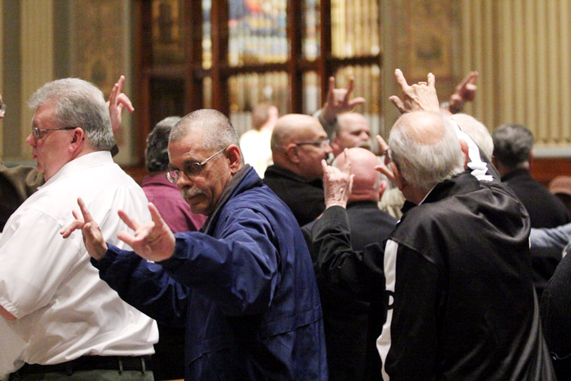
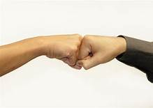
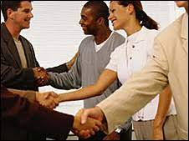
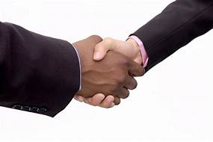

Slide 87
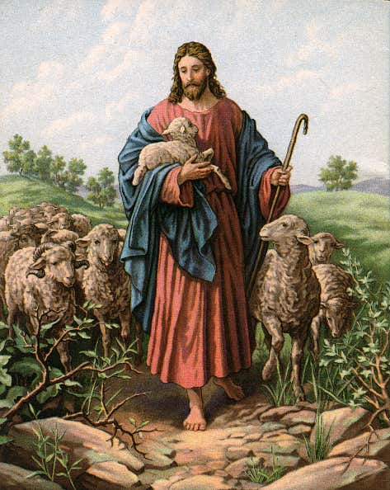
Lamb of God
Lamb of God
You take way the
si-ns of the world,
have mercy,
have mercy on us.

Slide 88
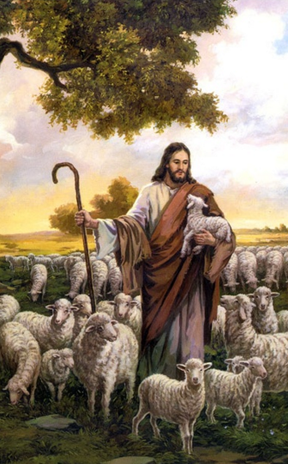
Lamb of God
Lamb of God
You take way the
si-ns of the world,
have mercy,
have mercy on us.

Slide 89
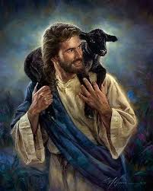
Lamb of God
Lamb of God
You take way the
si-ns of the world,
grant us,
gra-nt u-s peace.

Slide 90
Priest:
Behold the Lamb of God, behold Him who takes away the sins of the world. Blessed are those called to the supper of the Lamb..
All:
Lord I am not worthy that You should enter under my roof, but only say the word and my soul shall be healed.

Slide 92
Communion Hymn 1
The First Noel
By W. Sandy
Arr. By Dan Forrest

Slide 93
Verse 1
The first Noel the angel did say
Was to certain poor shepherds
in fields as they lay,
In fields where they lay
keeping their sheep
On a cold winter’s night
that was so deep.

Slide 94
Refrain
Noel, Noel, Noel, Noel!
Born is the King of Israel!

Slide 95
Verse 2
They looked up
and saw a star
Shining in the East beyond them far, And to the earth it gave great light,
And so it continued
both day and night.

Slide 96
Refrain
Noel, Noel, Noel, Noel!
Born is the King of Israel!

Slide 97
Verse 6
Then let us all
With one accord
Sing praises to our Heavenly Lord;
Who with the Father we adore,
And Spirit blest
For ever more.

Slide 98
Refrain
Noel, Noel, Noel, Noel!
Born is the King of Israel!

Slide 100
Communion Hymn 2
He Shall Reign
By Heather Sorenson

Slide 101
Verse 1
In the bleak mid-winter,
all creation groans
For a world in darkness,
frozen like a stone
Light is breaking
In a stable for a throne

Slide 102
And He shall reign
forevermore, forevermore
And He shall reign
forevermore, forevermore
Unto us a child is born
The King of kings and Lord of lords
And He shall reign forevermore, forevermore
Refrain

Slide 103
Verse 2
If I were a wise man,
I would travel far
And if I were a shepherd,
I would do my part
But poor as I am
I will give to Him my heart

Slide 104
And He shall reign forevermore, forevermore
And He shall reign forevermore, forevermore
Unto us a child is born
The King of kings and Lord of lords
And He shall reign forevermore, forevermore
Refrain

Slide 105
Verse 3
Here within a manger lies
The One who made the starry skies
This baby born for sacrifice
Christ, the Messiah
Into our hopes, into our fears
The Savior of the world appears
The promise of eternal years
Christ, the Messiah

Slide 106
He shall reign. (Gloria)
forevermore, forevermore
And He shall reign (Gloria)
forevermore, forevermore
He shall reign
forevermore, forevermore
^He shall reign (Gloria)
forevermore, forevermore
Refrain

Slide 107
Unto us a child is born
The King of kings and Lord of lords
And He shall reign forevermore, forevermore
Refrain

Slide 108
In Excelcis Deo!
He shall reign,
He shall reign,
He shall reign!
Outro

Slide 110
Communion Hymn 3
Silent Night
Arr. By Dan Forrest

Slide 111
Verse 1
Silent night, holy night
All is calm, all is bright
Round yon Virgin Mother and Child
Holy Infant so tender and mild
Sleep in heavenly peace
Sleep in heavenly peace

Slide 112
Verse 2
Silent night, holy night
Son of God, love's pure light
Radiant beams from Thy holy face
With the dawn of redeeming grace
Jesus Lord, at Thy birth!
Jesus Lord, at Thy birth!

Slide 114
Verse 3
Silent night, holy night
Wondrous Star lend Thy night
With the angels let us sing
“Alleluia” to our King
Christ the Savior is born!
Christ the Savior is born!

Slide 115
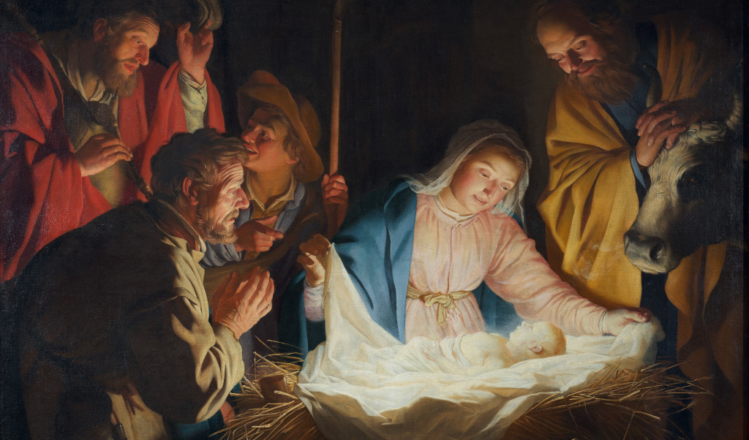

Slide 116

Recessional Hymn
Joy to the World
George F Hanel
1658-1759

Slide 117
Verse 1
Joy to the world, the Lord is come!
Let earth receive her King!
Let every heart prepare Him room,
and heav'n and nature sing,
and heav'n and nature sing,
and heav'n, and heav'n and nature sing.

Slide 118
Verse 2
Joy to the earth, the Savior reigns!
Let us our songs employ,
while fields and floods,
rocks, hills, and plains
repeat the sounding joy,
repeat the sounding joy,
repeat, repeat the sounding joy.

Slide 119
Verse 3
No more let sin and sorrow grow,
No thorns infest the ground.
He comes to make His blessings flow
Far as the curse is found
Far as the curse is found
Far as, Far is the curse is found

Slide 120
Verse 4
He rules the world with truth and grace,
and makes the nations prove
the glories of His righteousness
and wonders of His love,
and wonders of His love,
and wonders, wonders of His love.

Slide 121
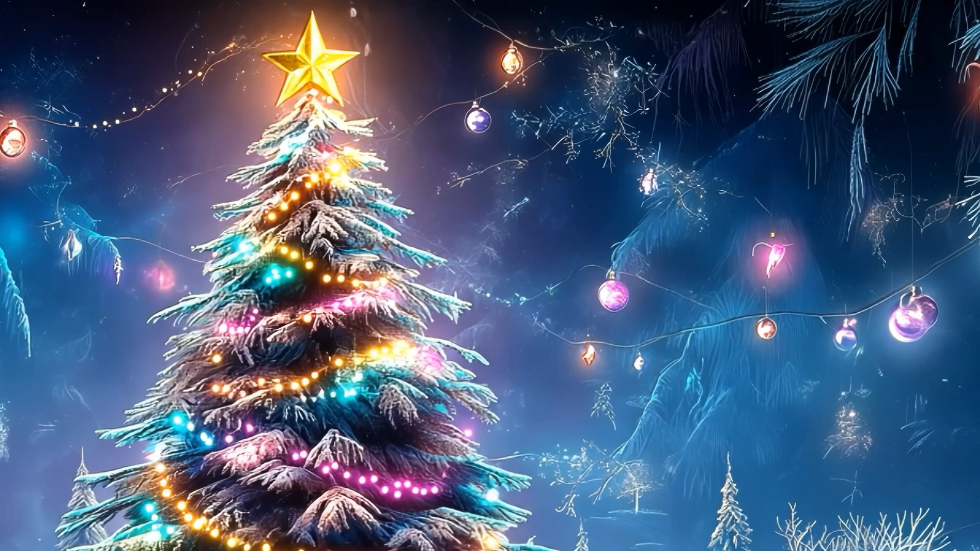
MERRY CHRISTMAS
TO YOU AND
YOUR FAMILY!
FROM SAINT JULIANA FAMILY

